Slide 1
Study of in vitro anticancer activity of the jujube seed extracts against the HCT 116 colorectal cancer cell line
Tille Vanlangendonck

Slide 2
Index
Introduction
Methodology
Results
Conclusion
Future prospects

Slide 3
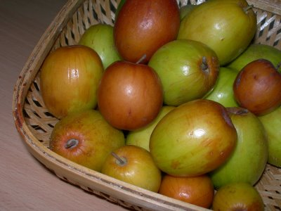
Introduction
Ziziphus mauritiana = jujube
Seeds from an old/ripe jujube
Seeds from a young/unripe jujube
Pharmaceutical effects
Seeds: sedative
Fruit: relieve cough and fever
Triterpenic acids
Betulinic acid (C₃₀H₄₈O₃)
Maslinic acid (C₃₀H₄₈O₄)
Oleanolic acid (C₃₀H₄₈O₃)
Notes:
Early studies have proven that some compounds from the jujube fruit have an anticancer activity. The aim of the study was to investigate the anticancer activity of the compounds from the seeds of the jujube. The fruit jujube looks like an apple but tastes more like a pear. During this research 2 type of seeds were used. The seeds from an old or ripe jujube and the seeds from an young or unripe jujube. The jujube has been used in many cultures because is has a lot of pharmaceutical effects. For example the seeds are sedative and can reduce nausea and abdominal pains in pregnancy. The fruit can relieve cough and fever and the juice is often used for cuts and ulcers. Experiments with the jujube fruit have been done for many years, researchers have discovered that both the seeds and the pulp contain triterpenic acids. These acids are natural compounds with beneficial properties for the human health. Studies with these acids showed an anticancer activity against cancer cell lines. A few examples of the triterpenic acids in the jujube are…

Slide 4
Methodology
Jujube seed
Maceration
Extract
Cytotoxicitytest
IC50
No apoptosis
DAPI
Apoptosis

Slide 5
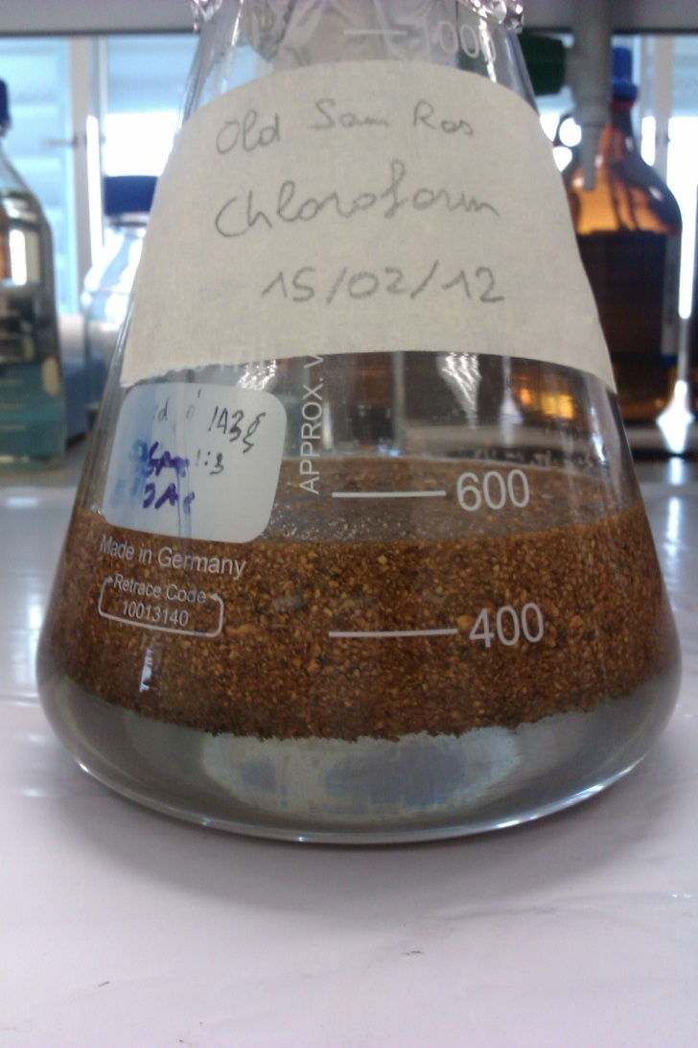
Methodology: Maceration
Soaking the plant material
6 solvents
Water
Ethanol
Dichloromethane
Ethylacetate
Chloroform
Hexane
Evaporation
Notes:
Maceration is a cold extraction technique, first the seeds are crushed into powder and then they are soaked with an alcoholic solvent. As you can see in the picture. We let this rest for 3 days and after that we seperate the solvent from the powder. The compounds of the seeds are then in the solvent, to purify the extract of the seeds we use the rotary evaporator. During this research, 6 solvents are used. So from each solvent we get an extract. My part of the research was only with the last 2 solvents, chloroform and hexane. Because we have 2 type of seeds and 2 type of solvents, we will have 4 extracts. ……

Slide 6
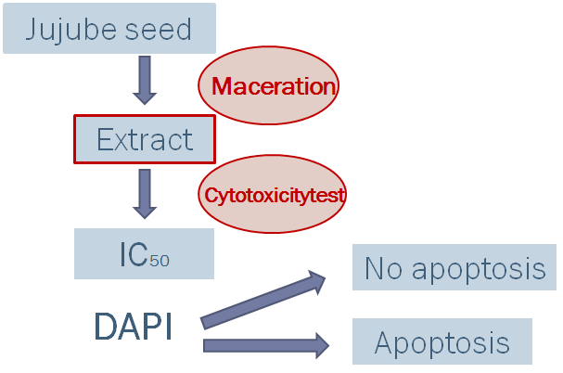
Methodology

Slide 7
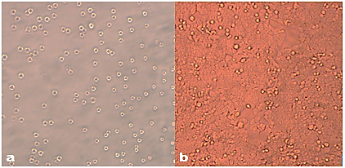
Methodology: HCT 116 cell line
Human colon
Colorectal carcinoma
Morphology
Unattached 10x
Attached 10x
Notes:
The cancer cell line that was used for the cytotoxicitytest was the HCT 116 colorectal cancer cell line. These are adherent epithelial cells from a human colon and they can grow into a colorectal carcinoma. The cell line is used because of his fast growth and because colon cancer is one of the top 5 most common cancers. The cells have a different morphology when they are attached on a flask. As you can see, on picture a) the cells are not attached yet and have a nice bright round shape but once they are attached the cells aren’t as bright anymore and also the round shape is not the same anymore.

Slide 8
Methodology: Cytotoxicitytest
Seeding cells
96-well plate
30.000 cells/well
Adding extract
Diluted in DMSO → 0,6% DMSO = 10% cytotoxicity
Concentration of 500 µg/ml → 0,5% DMSO
Notes:
Then we have the method of the cytotoxicity test, first the cells are seeded into a 96 well plate, and we try to seed the cells so we have around 30,000 cells /well. After a night of incubating the extract is added. But before it is added we first have to dilute it with DMSO. DMSO is a strong organic solvent but we have to be carefull because early studies have shown that 0,6% DMSO gives 10% cytotoxicity. So we really don’t want to let our cells die because of the DMSO and this means that we can not use a concentration of the extract that is higher then 500µg/ml because then we also add 0,5% DMSO

Slide 9
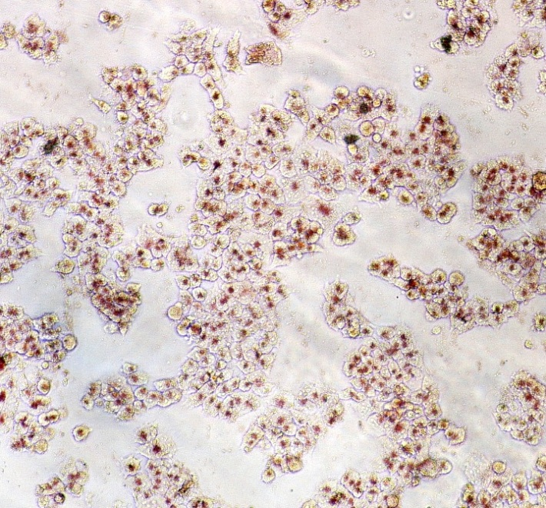
Methodology: Neutral red uptake assay
NR can penetrate both living and dead cells
Non-ionic diffusion
Living cells take up and bind NR in lysosomes
Lyse with 0,33% HCl in isopropanol
Spectrophotometer: 537/650 nm
IC50 calculated with the linear regression equation
Notes:
After seeding the cells and adding the extract the last step of the cytotoxicitytest can begin. The neutral red reuptake assay. We add the neutral red to the 96 well plate and then the NR will penetrate both living and dead cells with non ionic diffusion. The difference between the dead and living cells is that the living cells take up the NR and bind it in the lysosomes. So the NR will accumulate in the lysosomes, this means that the living cells have much more NR then the dead cells. After incubating and washing we lyse the cells with 0,33% HCL in isopropanol. This will set the NR free from the cells. The more living cells in a well the higher the intensity of the NR in the well. The intensity is measured with the spectrophotometer. With the results, an IC50 is calculated form the linear regression equation from the graph.

Slide 10
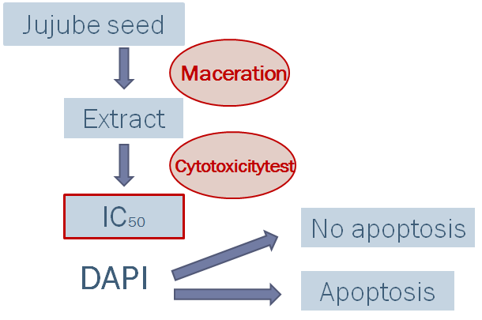
Methodology

Slide 11
Methodology: Cell death
Necrosis | Apoptosis
Because of cell damage | Self-induced by the body
Cell debris is released freely in the tissue | Cell debris is packed in vacuoles
Inflammatory reaction | No inflammatory reaction
Tissue damage → gangrene | No tissue damage
Notes:
So that’s why the apoptosis cell death is prefered

Slide 12
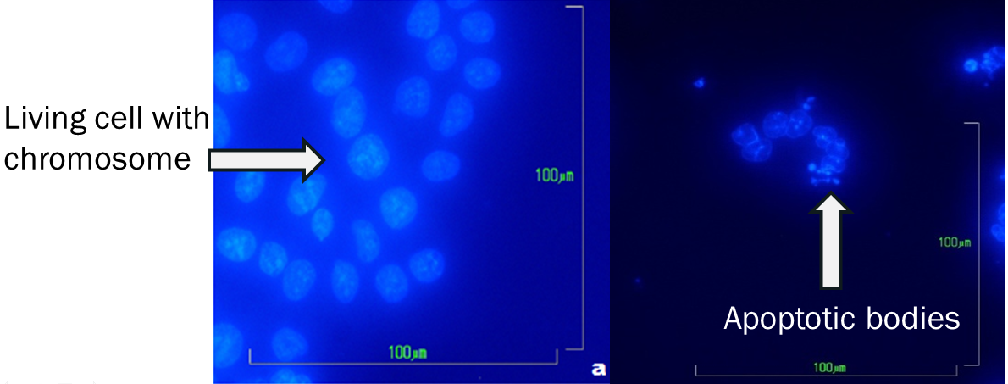
Methodology: DAPI-staining
Popular nuclear and chromosome counterstain
Emits a cyan blue light
Binds to AT regions of DNA
40x

Slide 13
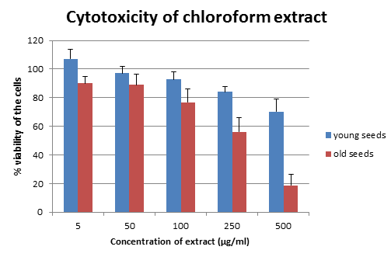
Results: Cytotoxicitytest
Extract from the seeds of the jujube with a chloroform maceration
IC50 = 779 µg/ml
IC50 = 290 µg/ml
Notes:
Here are the results from the cytotoxicitytest of the chloroform extracts. As you can see, both extracts can kill the cells, but only the extract from the old seeds have an IC50 that is not higher then 500 µg/ml.

Slide 14
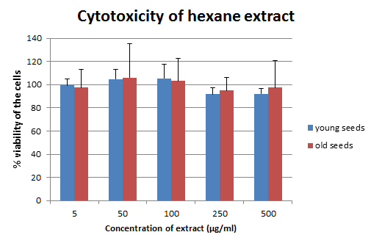
Results: Cytotoxicitytest
Extract from the seeds of the jujube with a hexane maceration
Almost no cell death, IC50 is not calculated

Slide 15
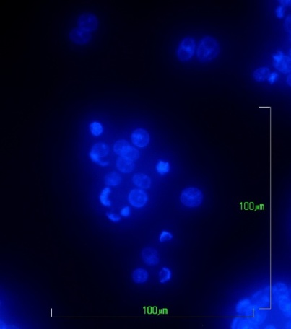
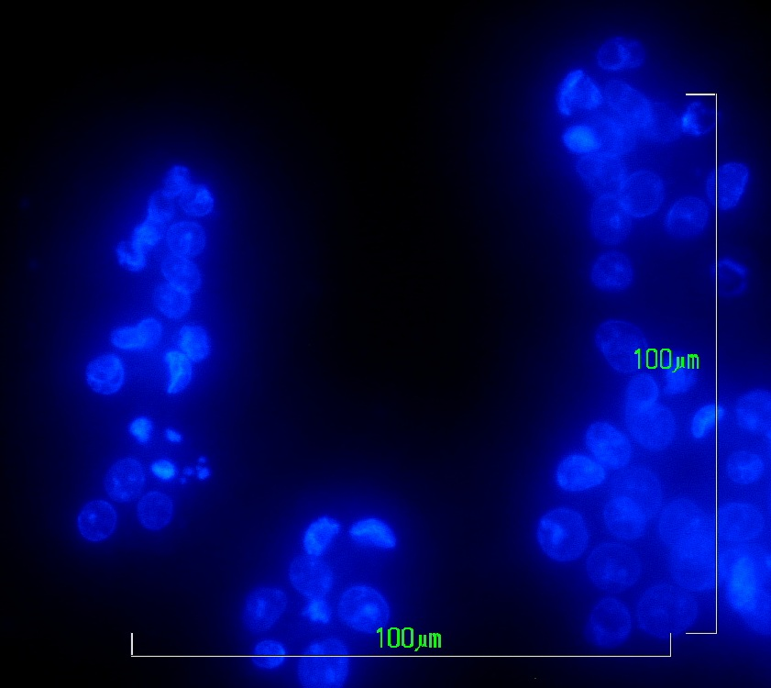
Results: DAPI-staining
Extract from chloroform maceration of the seeds from the old jujube
40x
40x

Slide 16
Conclusion
Chloroform maceration:
Anticancer activity
Seeds from young jujube: IC50 is too high
Seeds from old jujube: IC50= 290 µg/ml
Hexane maceration:
No anticancer activity
Cell death: apoptosis

Slide 17
Future prospects
Flow cytometry
Early or late apoptosis
DNA fragment analysis
Search the mechanism of apoptosis
Intrinsic or extrinsic

Slide 18
Study of in vitro anticancer activity of the jujube seed extracts against the HCT 116 colorectal cancer cell line
Tille Vanlangendonck

