Slide 1
Systematic analysis and visualisation of microarray studies
Sander Claus
Professional Bachelor Biomedical laboratory science
Bioinformatics
Tutor: | Peter Ghazal
Supervisor: | Nigel Binns
Belgian supervisor: | Raphaël Kiekens
2012 - 2013

Slide 2
Overview
Aim and hypothesis
Sterol pathway
Microarrays
Datasets
Workflow
Processing and visualisation of the data
Hypothesis testing
Conclusion

Slide 3
Aim and hypothesis
Aim
Process microarray data using R
Generate graphs
Test hypothesis
Hypothesis
Is the sterol pathway perturbed in a broad range of pathogen studies?
Does this occur in cells other than macrophages?
Is this a common theme for other pathogens?
Notes:
Perturbed = verstoord

Slide 4
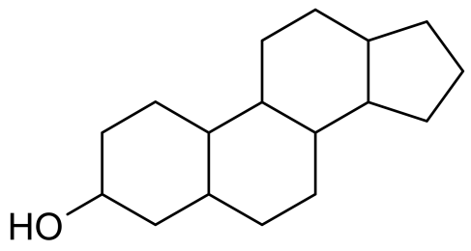
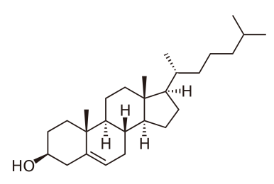
Sterol pathway
Function of sterols
Physiology of the cell
Protection of cells against infection
Interference of the pathway
Statins:
Interfere with mevalonate pathway through inhibition of HMG-CoA
Used in cholesterol treatment
IFN: down regulation (important for macrophage host defence)
Notes:
HMG-CoA = 3-hydroxy-3-methylglutaryl-coenzyme A

Slide 5
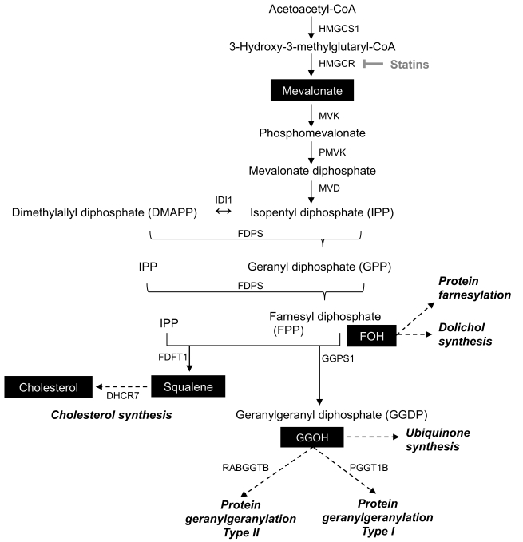
Sterol pathway
Acetyl-CoA
Mevalonate pathway
Mevalonate
Isoprenoid pathway
Farnesyl-PP
Sterol biosynthesis
Cholesterol

Slide 6
Genes of the sterol pathway
Symbol | Name
Acat1 | Acetyl-CoA acetyltransferase 1
Acat2 | Acetyl-CoA acetyltransferase 2
Hmgcs2 | 3-hydroxy-3-methylglutaryl-CoA synthase 2
Hmgcl | 3-hydroxy-3-methylglutaryl-CoA lyase
Hmgcr | 3-hydroxy-3-methylglutaryl-CoA reductase
Mvk | Mevalonate kinase
Pmvk | Phosphomevalonate kinase
Mvd | Mevalonate diphosphate decarboxylase
Idi1 | Isopentenyl-diphosphate delta isomerase 1
Idi2 | Isopentenyl-diphosphate delta isomerase 2
Fdps | Farnesyl diphosphate synthase
Ggps1 | Geranylgeranyl diphosphate synthase 1
Dhdds | Dehydrodolichyl diphosphate synthase
Fdft1 | Farnesyl-diphosphate farnesyltransferase
Sqle | Squalene monooxygenase
Lss | Lanosterol synthase
Dhcr24 | 24-dehydrocholesterol reductase
Cyp51a1 | Lanosterol 14 alpha-demethylase
Tm7sf2 | Delta(14)-sterol reductase
Sc4mol | Sterol-C4-methyl oxidase
Nsdhl | Sterol-4-alpha-carboxylate 3-dehydrogenase
Hsd17b7 | 3-keto-steroid reductase
Ebp | Emopamil binding protein (sterol isomerase)
Sc5d | Sterol-C5-desaturase
Dhcr7 | 7-dehydrocholesterol reductase

Slide 7
Microarrays
Detect changes in gene expression levels in response to different conditions
Hybridisation between two single stranded DNA molecules (target and probe)
Workflow
Notes:
1. Staal = behandelde cellen
2. mRNA isoleren
3. mRNA → cDNA
4. Kleurstof
5. Hybridiseren op array (probes! Affymetrix → perfect match/mismatch)
6. Scannen
7. Analyse

Slide 8
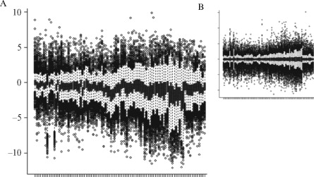
Microarrays Data analysis
 | Treatment 1 | Treatment 2 | Treatment 3 | Treatment 4
Gene 1 | Exp_{1,1} | Exp_{1,2} | Exp_{1,3} | Exp_{1,4}
Gene 2 | Exp_{2,1} | Exp_{2,2} | Exp_{2,3} | Exp_{2,4}
Gene 3 | Exp_{3,1} | Exp_{3,2} | Exp_{3,3} | Exp_{3,4}
Gene 4 | Exp_{4,1} | Exp_{4,2} | Exp_{4,3} | Exp_{4,4}
Background correction
Log2 transformation
Normalisation
Microarray Suite 5.0 (MAS5)
Robust Multichip Average (RMA)
Gene expression
Probes
Notes:
Achtergrondcorrectie → ruis elimineren
Log2 transformeren → normale verdeling
Normaliseren → data rechtstreeks vergelijkbaar maken tss arrays (figuur)

Slide 9
Microarrays Data analysis
Microarray Suite 5.0 (MAS5)
Background correction: subtracting mean intensity of lowest 2% spots
PM-MM
Tukey’s biweight algorithm
Robust Multichip Average (RMA)
Calculation of background signal: background estimation of entire chip → subtract from PM-intensities.
Quantile normalisation
Median polish summarisation
Notes:
PM = perfect match, MM = mismatch (non-specifieke hybridisatie)
Tukey’s biweight = gebruikt afstand tss mediaan & metingen
Kwantiel normalisatie = 2 verdelingen identiek maken in statistische eigenschappen
Median polish = gebruikt mediaan rijen en kolommen

Slide 10
Datasets
Dataset | Organism | Cell type | Description
GSE30457 | Mouse | Fibroblasts | Effect of IFNα and IFNγ in absence and presence of CHX
GSE30550 | Human | Peripheral blood | Response to influenza virus infection
GSE17948 | Human | Monocytes | Effect of EGFR on HCMV-infection
GPX-000029 (MITH24) | Mouse | BMDM | Effect of IFNα and IFNγ on MCMV-infection
RNA_half_ life_kevin | Mouse | BMDM | Effect of IFNγ on RNA-synthesis

Slide 11
Datasets
Dataset | Organism | Cell type | Description
GPX-000008 | Mouse | BMDM | Effect of phagocytosis of apoptotic cells
GPX-000011 | Mouse | BMDM | Effect of MCMV infection
GPX-000029 | Mouse | BMDM | Role of IFNα and IFNγ in MCMV infection
GPX-000044 | Mouse | BMDM | Mock infection
GPX-000050 | Mouse | BMDM | Effect of Bordetella pertussis adenylate cyclase toxin
GPX-000068 | Mouse | BMDM | Effect of virus infection

Slide 12
Workflow
GEO
Raw data
Annotations
R
Visualisation
GEVisE
Genes
Pathways
R
Normalisation
Confirm or reject hypothesis
GPX
Raw data
R
Student’s T-test
Fisher’s exact test

Slide 13
Processing and visualisation of the data
Retrieve data and annotations
Normalise data
MAS5
RMA
Further processing
Sorting
Mean
...
Export files
Plot data

Slide 14
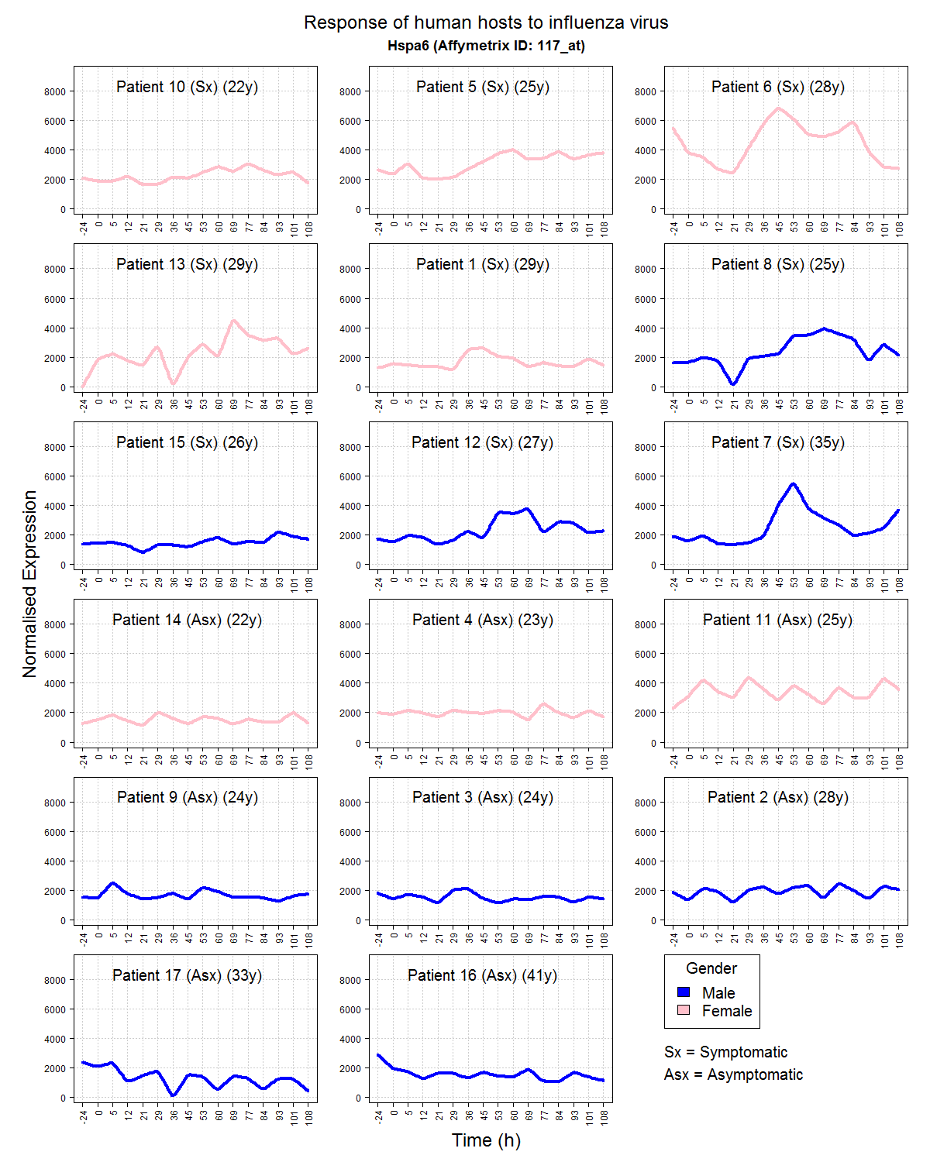
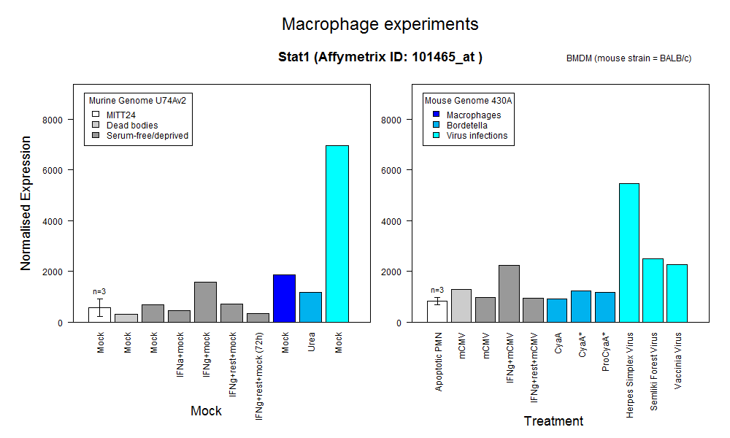
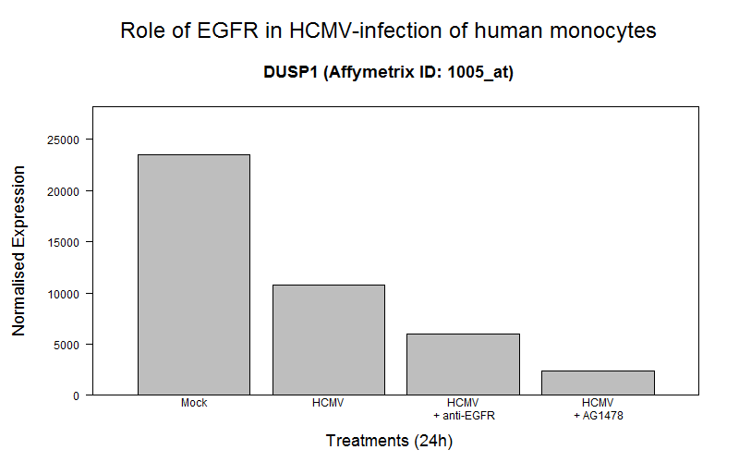
Processing and visualisation of the data
Retrieve data and annotations
Normalise data
MAS5
RMA
Further processing
Sorting
Mean
...
Export files
Plot data

Slide 15
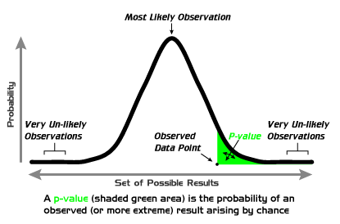
Hypothesis testing
Student’s T-test
Test if two groups of data are significantly different
Result → P-value
Fisher’s exact test
Test to assess relationship between two conditions
Uses N to calculate P-value
 | Significant | Not significant | Total
Sterol genes | a | b | a+b
Not sterol genes | c | d | c+d
Total | a+c | b+d | N (=a+b+c+d)
Notes:
Groepen data: controle vs behandeling (per gen!)
T-test → t-waarde → t-distributietabel → p-waarde
Fisher → contigency tabel

Slide 16
Hypothesis testing
Normalise data
Perform T-test
Split data in different categories
Create contingency tables
Perform Fisher’s exact test

Slide 17
Hypothesis testing
GSE30457 |  |  |  | GPX-000029 (MITH24)
Mock without CHX | IFNα without CHX | 0.062245282 |  | CM | CC | 1
Mock without CHX | IFNγ without CHX | 3.41E-05 |  | CM | AM | 0.027072473
Mock with CHX | IFNα with CHX | 0.179046704 |  | CM | GC | 0.31970225
Mock with CHX | IFNγ with CHX | 1 |  | CM | GM | 0.196831051
 |  |  |  | CM | GRC | 0.248411036
 |  |  |  | CM | GRM | 6.00E-12
 |  |  |  | CM | GRM72 | 0.04026449
GSE17948 |  |  |  | GPX-000050
Mock | HCMV | 0.665235594 |  | Urea | Cya | 0.032416526
Mock | HCMV + anti EGFR | 0.422543076 |  | Urea | Cya* | 0.002359388
Mock | HCMV + AG1478 | 0.011301786 |  | Urea | proCyaA* | 0.197035284
Legend of GPX-000029
Sample | Pretreatment | Treatment | Infection | Time
CM | / | / | Mock | 24h
CC | / | / | mCMV | 24h
AM | IFNα | IFNα | Mock | 24h
GC | IFNγ | IFNγ | mCMV | 24h
GM | IFNγ | IFNγ | Mock | 24h
GRC | IFNγ | / | mCMV | 24h
GRM | IFNγ | / | Mock | 24h
GRM72 | IFNγ | / | Mock | 72h
Notes:
------------ GSE30457 ------------
- CHX inhibeert aanmaak Ch25h
- Ch25h gereguleerd dr Stat1, Stat1 dr IFN
------------ GSE17948 ------------
- EGFR = epidermal growth factor receptor
- EGFR speelt rol in binnendringen virus, EGFR-antilichaam en inhiberende agent gebruikt om receptor te blokken
------------ MITH24 ------------
- Effect IFN bij aan/afwezigheid mCMV
- mCMV induceert werking IFN
------------ GPX-50 ------------
- Effect van adenylate cyclase toxin (CyaA) op BMDM
- CyaA: wild type
Cya*: invasief, niet actief
proCyaA*: niet invasief, niet actief

Slide 18
Conclusion
Processing microarray gene expression
Visualise data as graphs
Upload graphs to GEVisE
Use data in Fisher’s exact test
Confirm/reject hypothesis
GSE30457 → future project

Slide 19
Systematic analysis and visualisation of microarray studies
Sander Claus
Professional Bachelor Biomedical laboratory science
Bioinformatics
Tutor: | Peter Ghazal
Supervisor: | Nigel Binns
Belgian supervisor: | Raphaël Kiekens
2012 - 2013

