Slide 1
Reconstruction of the tropolone biosynthetic pathway in Aspergillus oryzae
Jeroen Maertens
Tutor: Dr. Colin M Lazarus
Promoter: Stefanie Salliau

Slide 2
Content
Introduction
Previous work
Plasmid construction
A. oryzae transformation and growth
Extraction
LC-MS analysis
Conclusion and future work

Slide 3
Introduction
Source of genes
Talaromyces stipitatus
Acremonium strictum
Tropolone synthesis
Why tropolones
Why Aspergillus oryzae

Slide 4
Previous work
Tropolone biosynthetic pathway
Analysis of genome
Analysis of cluster
Knock out of genes
Enzymatic research
Published pathway (Davison et al.)
Construction of starter vector

Slide 5
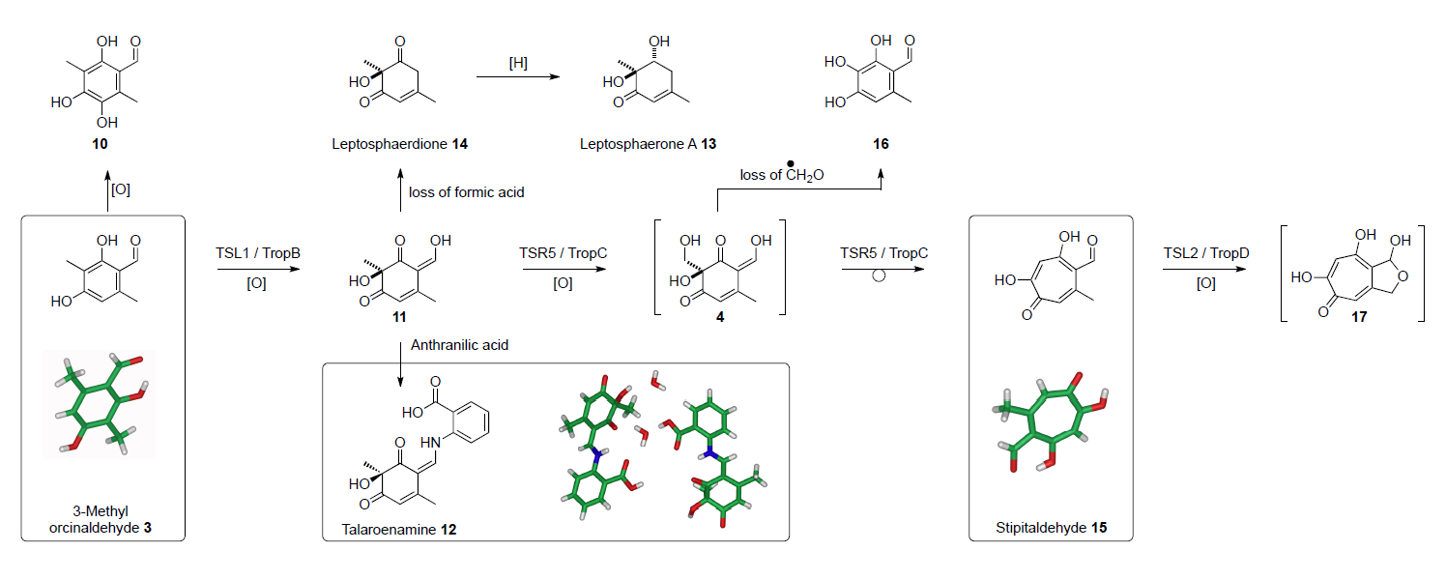
Tropolone biosynthetic pathway

Slide 6
Plasmid construction
Starter vector
Yeast recombination
Vector digestion

Slide 7
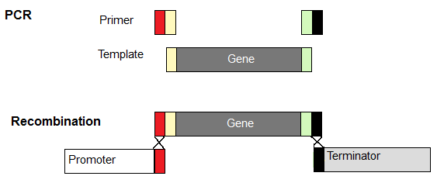
Plasmid construction
Starter vector
Yeast recombination
Vector digestion
PCR

Slide 8
Plasmid construction
Starter vector
Yeast recombination
Vector digestion
PCR
Gateway® recombination

Slide 9
Plasmid construction
Starter vector
Yeast recombination
Vector digestion
PCR
Gateway® recombination

Slide 10
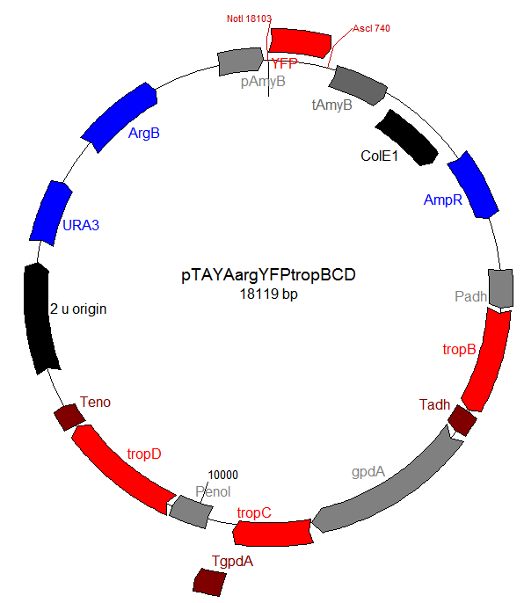
Plasmid construction
Starter vector
Yeast recombination
Vector digestion
PCR
Gateway® recombination
Ligation

Slide 11
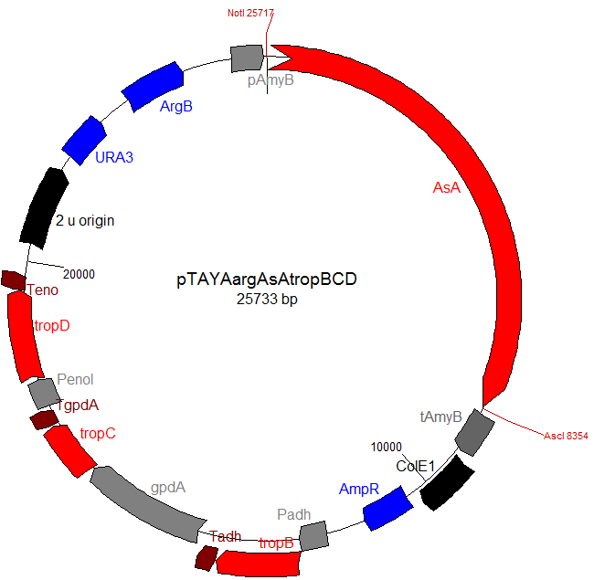
Plasmid construction
Starter vector
Yeast recombination
Vector digestion
PCR
Gateway® recombination
Ligation

Slide 12
Plasmid construction Overvieuw

Slide 13
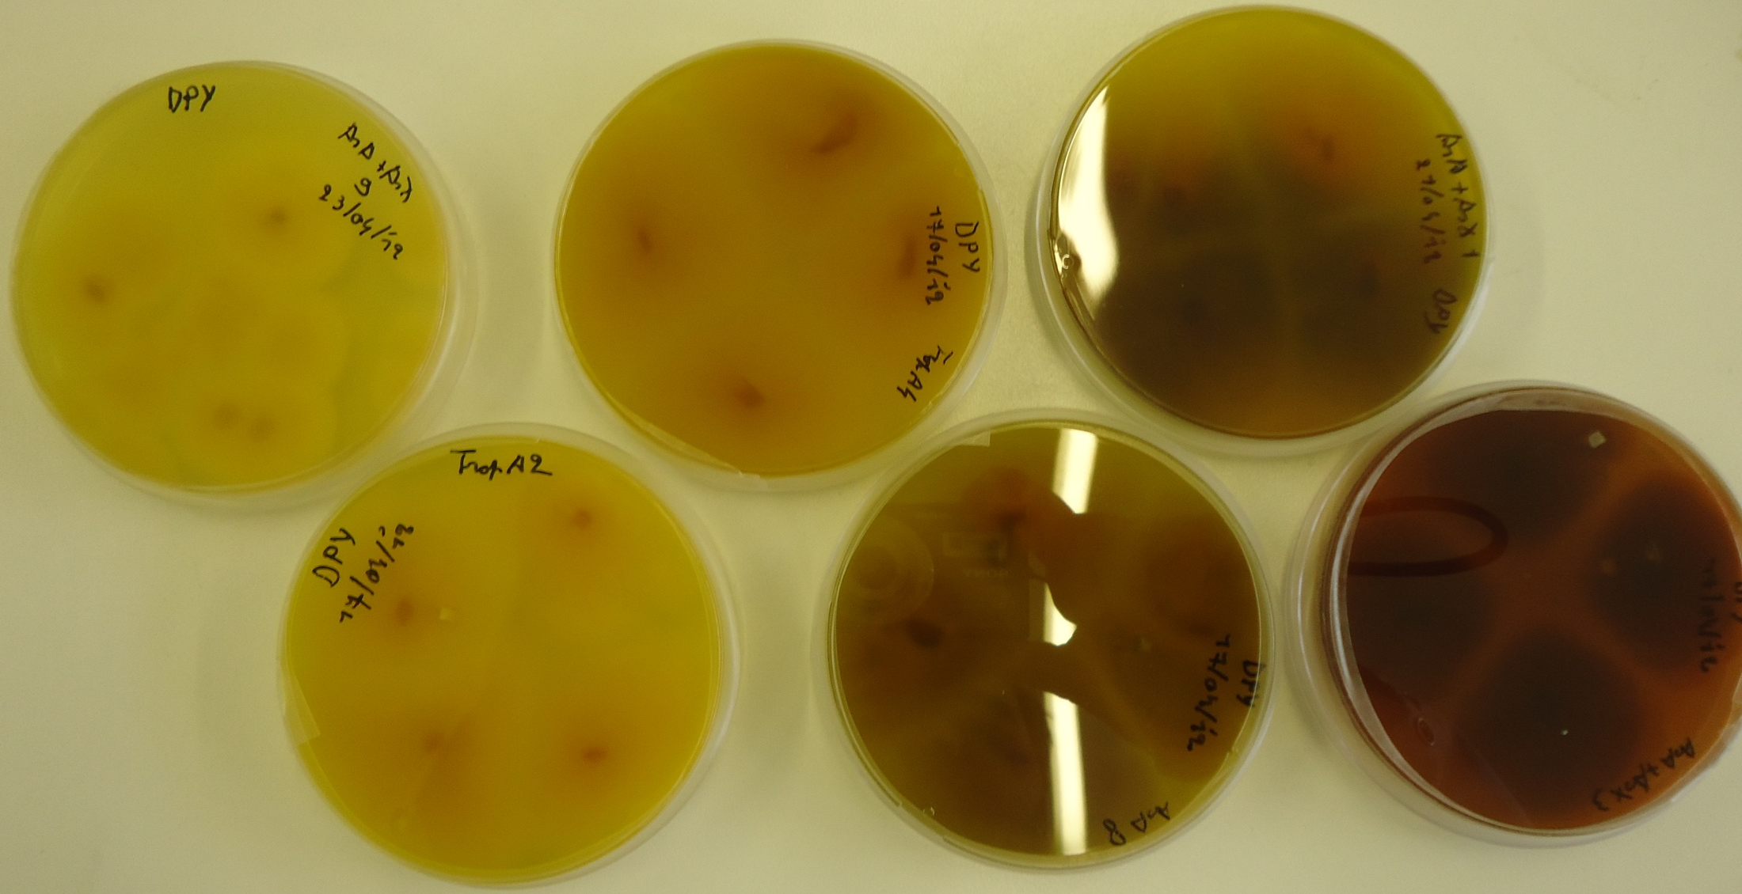
A. oryzae transformation and growth

Slide 14
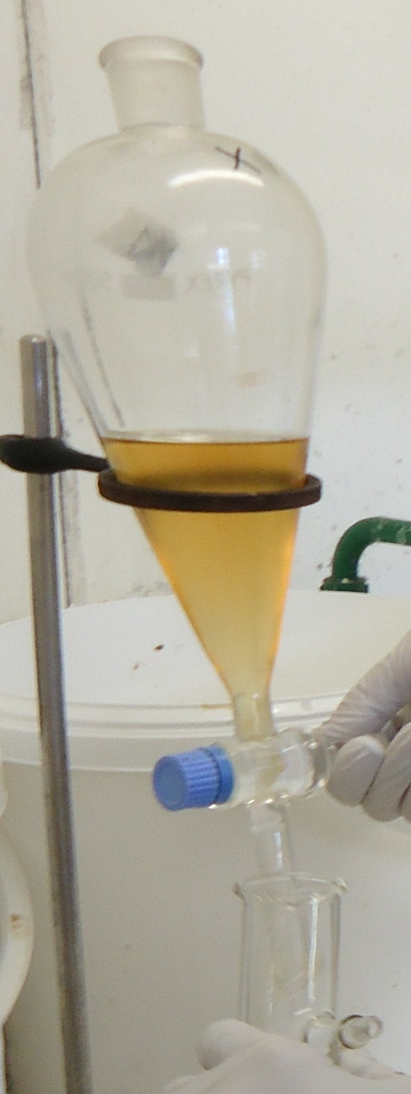
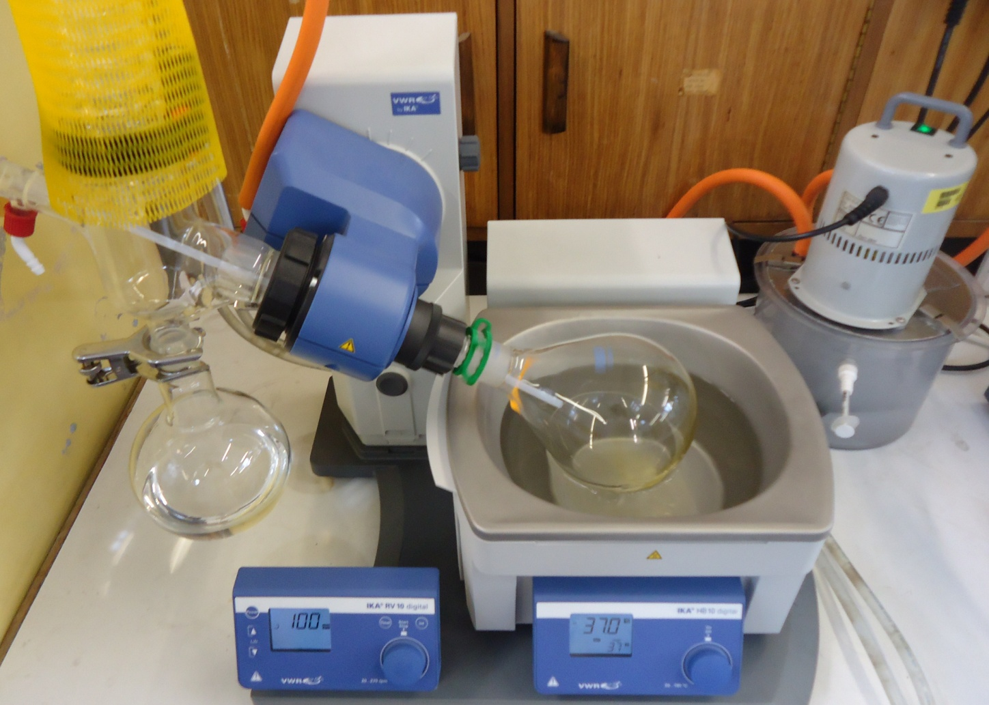
Extraction

Slide 15
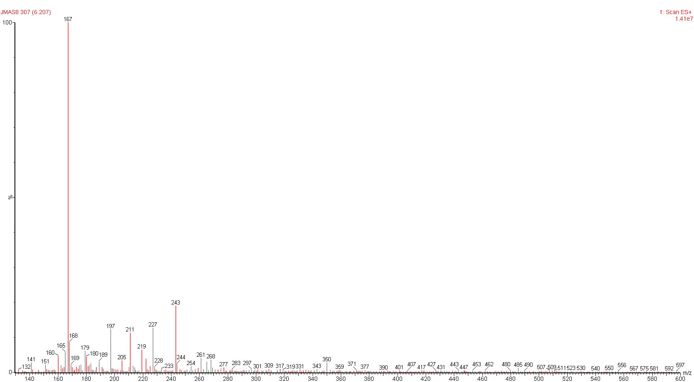
LC-MS analysis
Some new metabolites
High production
First two genes active
Third gene?

Slide 16
Conclusion
Some metabolites as expected
First two genes active
No tropolone formed
Future work
Gene expression levels
Third gene

Slide 17
Reconstruction of the tropolone biosynthetic pathway in Aspergillus oryzae
Jeroen Maertens
Tutor: Dr. Colin M Lazarus
Promoter: Stefanie Salliau

