Slide 1


Development of new calpain/cathepsin FRET-biosensors for necroptosis assessment in living cells
Sarah Druwé – Bachelor student Howest Brugge
Supervisors: Sipieter F., Riquet F., Jouan-Lanhouet S.
Promotor: Salliau S.

Slide 2
Overview
Introduction
  Cell death
  Pathway of necroptotic
  Mixed lineage kinase domain-like (MLKL)
  FRET-biosensors
Aims
Experimental design & Results
  Build FRET-biosensor for protease activity
  Transfected biosensor in living cells
  Imaged protease activity
Conclusion

Slide 3
Introduction
Cell death
Pathway of necroptosis
Mixed Lineage Kinase domain-Like
FRET-biosensors

Slide 4
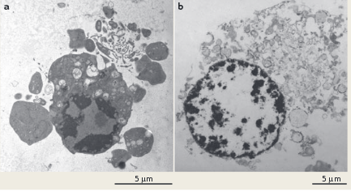
Cell death morphoglogy
Source: Vandenabeele P. - Molecular mechanisms of necroptosis: an ordered cellular explosion
2 forms of cell death: apoptosis and necrosis
Necroptosis: regulated form of necrosis
Notes:
- There are two forms of cell death: apoptosis and necrosis – very shortly mention the morfological differences
Discovered that necrosis also can be stimulated by different stimuli like TNF => regulated
source

Slide 5
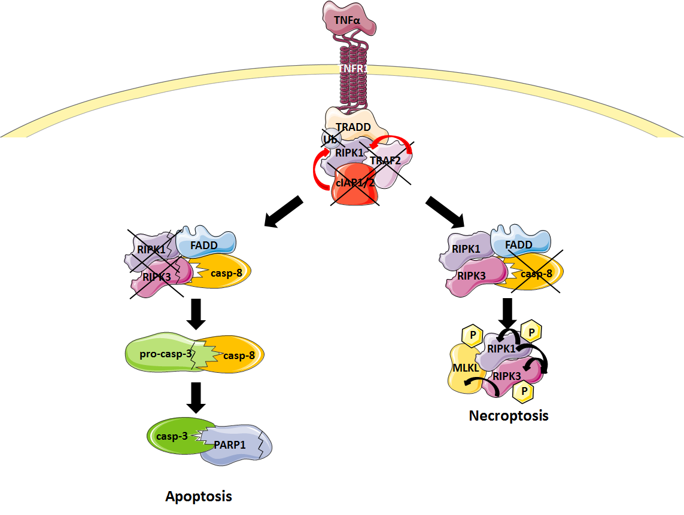
Signaling pathway
Source: Sipieter F. - Shining light on cell death processes – a novel biosensor for necroptosis, a newly described cell death program
Notes:
Pathway of apoptosis and necroptosis (mention the differences and discuss different components by necroptosis)
In this example:
* binding of TNF-α activates the receptor on the membrane
* activation of intracellular proteins that can interact with eachother and form a first complex.
* second complex death inducing signalling complex can further be formed and can result in apoptosis or necrosis. If RIPK1 and 3 are inactive apoptosis is induced, if caspase-8 is inactive necroptosis will be induced.
*RIPK1 and 3 are capable to phosphorylate each other if they are activated and form a new complex the necrosome. A recent discovered molecule is mixed lineage kinase like protein (MLKL) and can be phosphorylated by RIPK3. Not much is known about this protein so research is important.
*A new research on this protein is to search if MLKL is cleaved by proteasen during necroptosis. These proteases are maybe cathepsins that are present during necroptosis.

Slide 6
Mixed lineage kinase domain-like (MLKL)
New discovered component in the necrosome
Research on kinase-activity and localization
Biochemical approaches: MLKL antibodies
Protease biosensor
  Identified substrates on MLKL
  Potentially cleaved by calpains or cathepsins
Notes:
MLKL is a new discovered component in the necrosome and there is a lot of research on it.
First the research is on the kinase-activity and interaction with RIP-kinases. Second they research the localisation.
Further some biochemical approaches like MLKL-antibodies, these aren’t optimal and still lacking.
A new thought was to make a protease biosensor to discover protease activity on MLKL, therefore they have identified specific substrates on MLKL that can be potentially cleaved by calpaïns or cathepsins.

Slide 7
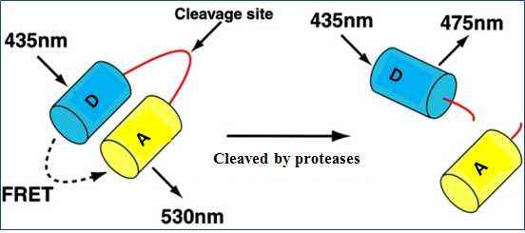
FRET-biosensors
FRET (förster resonance energy transfer) is a physical phenomen where radiationless energy can be transferred from donor to acceptor
Example of biosensor: Protease activity biosensors
  2 fluorescent proteins
  Sequence with cleavage site
Notes:
What is FRET (on slide)
There are different types of biosensors, we developed the protease-biosensor so we are going to discuss this one.

Slide 8
Aims
Development of new FRET- biosensors for protease activity
  based on identified cleavage sites on MLKL for calpains and cathespins
Monitor protease activity during necroptosis after introduction in cells
Notes:
The aim of this project was to develop new FRET-biosensors for protease activity, these biosensor must be transfected in living cells and be observed with a microscope to monitor protease activity in living cells

Slide 9
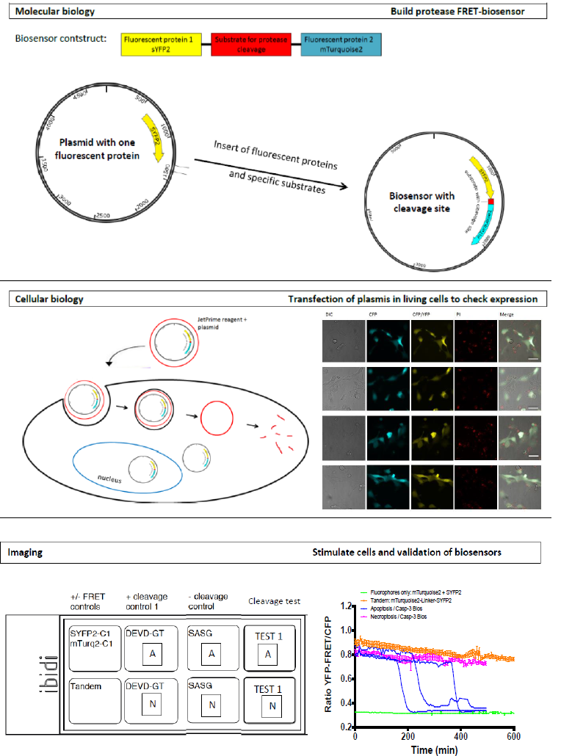
Experimental design & results
Cloning FRET-biosensor
Expression in living cells
Imaging

Slide 10
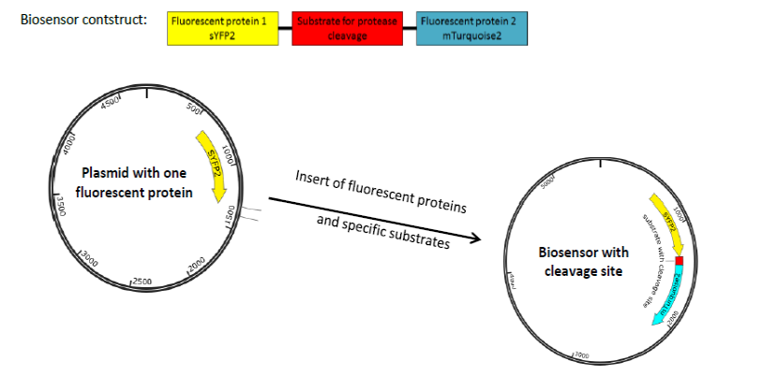
Build a protease FRET biosensor
Molecular biology

Slide 11
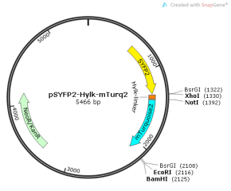
Build a biosensor backbone
pSYFP2-Hylk-mTurquoise2

Slide 12
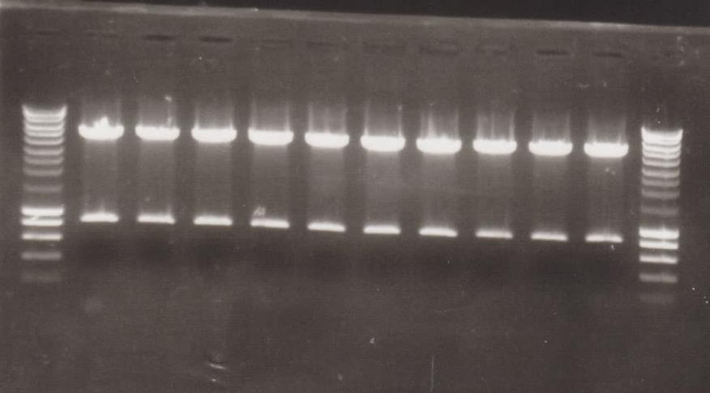
Build a biosensor backbone
Control of biosensor backbone
Digest with BsrGI - Expected bands on 786 and 4680 bp
10 positive clones
M 1 2 3 4 5 6 7 8 9 10 M
± 5000 bp
M | Merker
1-5 | Ligatie 1/3 Cl1-5
6-10 | Ligatie 1/8 Cl1-5
± 800 bp

Slide 13
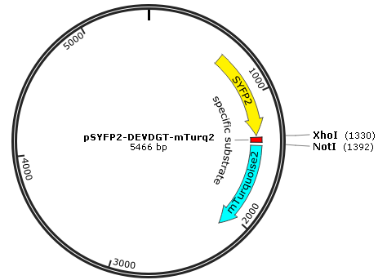
Insert specific substrates
calpains or cathepsins cleavage sites
Caspase-3 cleavage sites(positive control): DEVD
Negative control (not cleaved by caspase-3): SASG

Slide 14
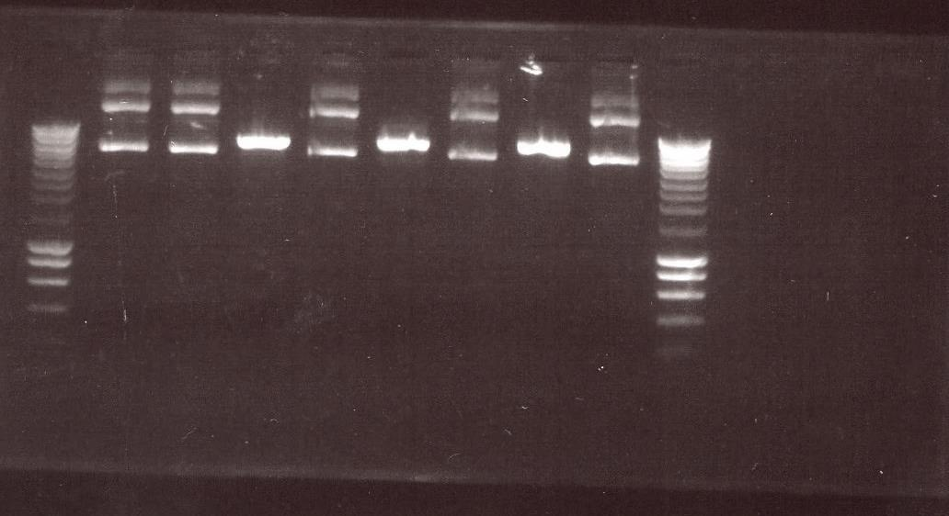
Insert specific substrates
Control of biosensor with specific cleavage site
Digest with unique restriction site in insert
Difference between cut and uncut
M 1c 1u 2c 2u 3c 3u 4c 4u
C | Geknipt (Cut)
U | Ongeknipt (Uncut)
1 | DEVD-KL Cl3
2 | DEVD-KL Cl8
3 | DEVD-GT Cl18
4 | DEVD-GT Cl20

Slide 15
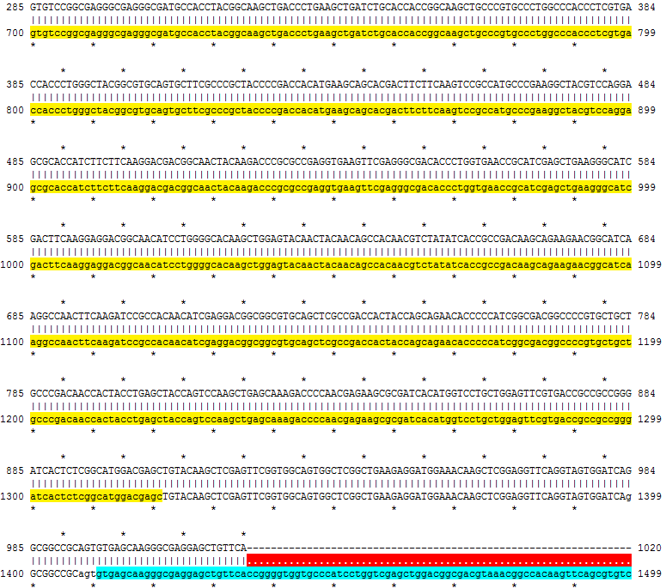
Insert specific substrates
Control all the biosensors with sequencing
#5-Cl2(CMV-FW).ape | DEVD-GA | OK
#5-Cl3(CMV-FW).ape | DEVD-GA
#6-Cl3(CMV-FW).ape | aEELLLLLQ | OK
#6-Cl5(CMV-FW).ape | aEELLLLLQ | OK
#7-Cl1(CMV-FW).ape | aAEEDGN | OK
#7-Cl2(CMV-FW).ape | aAEEDGN | OK
#8-Cl4(CMV-FW).ape | aDQQDAD | OK
#8-Cl5(CMV-FW).ape | aDQQDAD | OK
#9-Cl1(CMV-FW).ape | aKELSLLLQ | OK
#9-Cl3(CMV-FW).ape | aKELSLLLQ | OK
DEVD-GT_Cl18(CMV-FW).ape | DEVD-GT | OK
DEVD-GT_Cl20.ape | DEVD-GT | OK
DEVD-KL_Cl3(CMV-FW).ape | DEVD-KL
DEVD-KL_Cl8(CMV-FW).ape | DEVD-KL | OK
SASG_Cl12(CMV-FW).ape | SASG
SASG-Cl10(CMV-FW).ape | SASG | OK

Slide 16
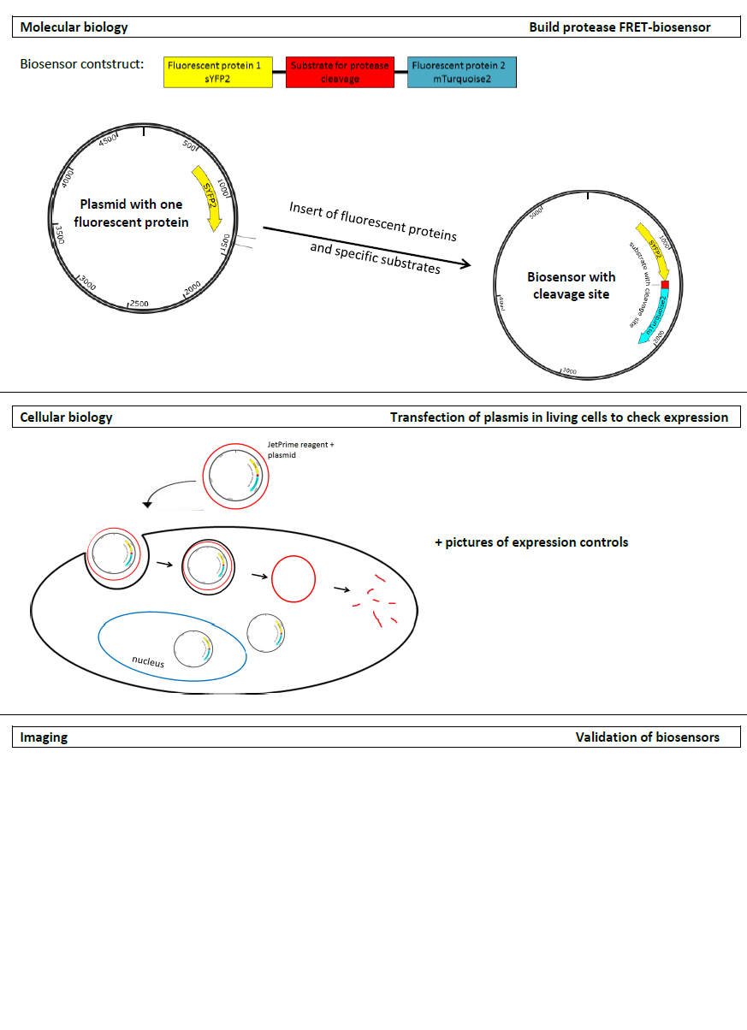
Transfect plasmids in living cells
Cellular biology

Slide 17
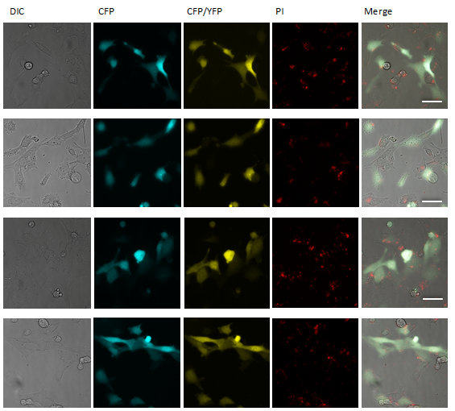
Transfect plasmids in living cells
Expression control
Two fluorophores only,
sYFP2 & mTurquoise2
pSYFP2-Hylk-mTurquoise2 (backbone)
Biosensor with cleavage site for caspase-3 + apoptotic trigger
Biosensor with cleavage site for caspase-3 + necroptotic trigger

Slide 18
Imaging
Kinetics of MEF-cells
  To see when cell death occurs after stimulation
  Use: FLUOstar and Sytox Green
Stimulate transfected cells
Observe cells 12h with microscopy
Biosensor control: Fluorescent proteins only | No stimuli
Biosensor control: Biosensor backbone | No stimuli
Caspase-3 Biosensor (DEVD-GT) | Apoptotic stimuli
Caspase-3 Biosensor (DEVD-GT) | Necroptotic stimuli

Slide 19
Kinetics of MEF-cells
Stimulate cells with apoptotic and necroptotic stimuli
To see when cell death occurs
All cells are dead after 10-12hours

Slide 20
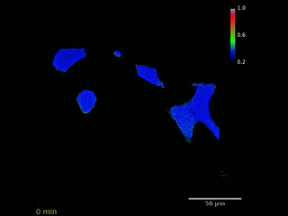
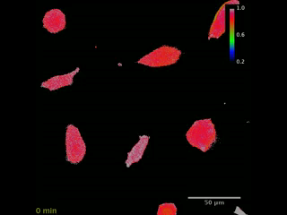
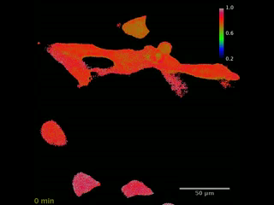
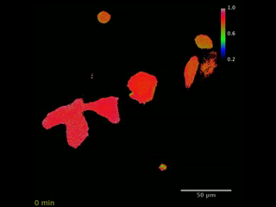
Imaging
Fluorophore only => NO FRET
Biosensor backbone => FRET
Biosensor + apoptotic stimuli
Biosensor + necroptotic stimuli

Slide 21
Imaging
Convert videos to graph with ImageJ and excel
Graph: ratio YFP-FRET/CFP in time

Slide 22
Conclusion
All plasmids are correct
Transfection worked => cells expressed
Positive control (DEVD-GT) => cleavage
Future perspectives
  Transfect and image all the other controls
  Transfect and image the calpains/cathepsins biosensors

Slide 23
Thanks for your attention

Slide 24
Development of new calpain/cathepsin FRET-biosensors for necroptosis assessment in living cells
Sarah Druwé – Bachelor student Howest Brugge
Supervisors: Sipieter F., Riquet F., Jouan-Lanhouet S.
Promotor: Salliau S.

Slide 25
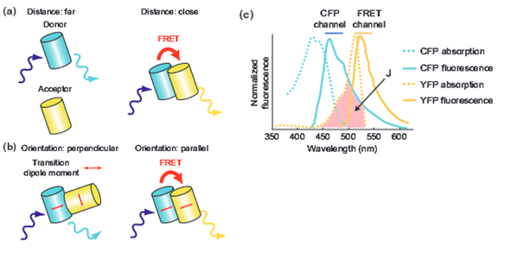
Three requirements for FRET to occur
Distance
Oriëntation
Spectrum

Slide 26
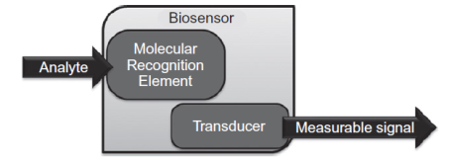
Analyte: proteases
Molecular recognition element: Specific cleavage site
Transducer: Two fluorescent proteins
Measurable signal: difference in fluorescence

Slide 27
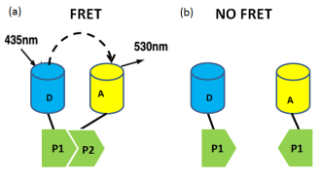
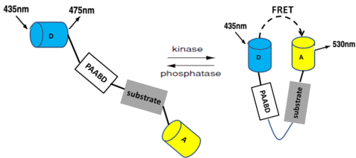
Biosensors

Slide 28
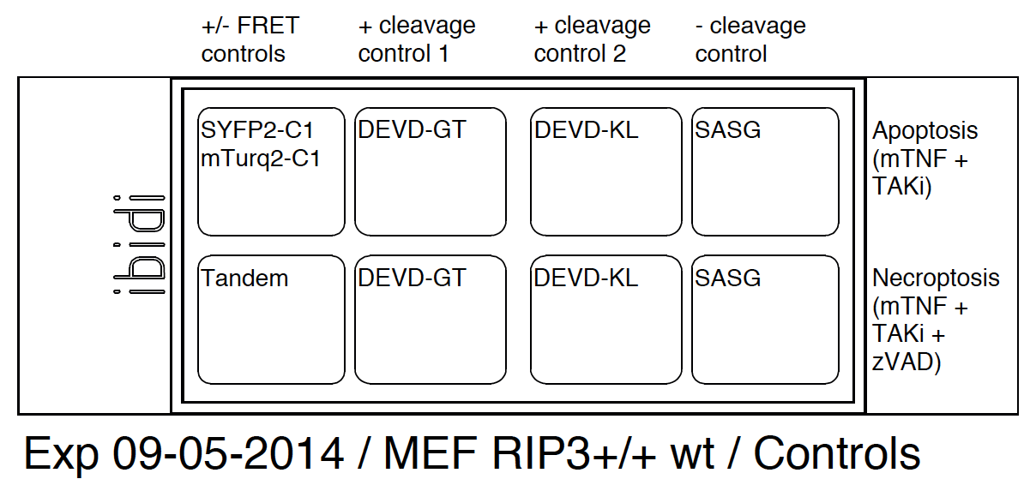
Imaging
Stimulate cells
Only DEVD-GT images were analysed
No stimuli (X) | Medium + PI
Apoptotic stimuli (A) | Medium + PI + mTNF + TAKi
Necroptotic stimuli (N) | Medium + PI + mTNF + TAKi + zVAD
X
A
X
N

