Slide 1
A comparison of somatic mutation callers in breast cancer samples and matched blood samples
Thomas Bretonnet
Bioinformatics and computational biology unit University of Pretoria
Notes:
The title of my bachelor thesis is “A comparison of somatic mutation callers in breast cancers samples and matched blood samples”. I followed an internship at the Bioinformatics and Computational Biology Unit at the University of Pretoria in South Africa.

Slide 2
Table of contents
Somatic Single Nucleotide Variations
Samples
Mutation Calling Tools
Preprocessing
Standard parameters
Optimized parameters
Conclusion
Future perspectives
Notes:
First of all I will give some overall information about the somatic Single Nucleotide Variations. Next, some information about the Samples I used to detect the SNVs. Some things about the Mutation Calling Tools and the Preprocessing steps. Then the results with standard and optimized parameters of the Mutation Calling Tools. To finalize with a brief Conclusion and Future perspectives.

Slide 3
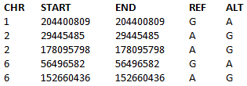
Somatic Single Nucleotide Variations
Variants
Insertions
Deletions
Polymorphisms
Origin + development
Cancer
Treatments
Notes:
Identifying somatic single nucleotide variations (SNVs), insertions, deletions and single nucleotide polymorphisms (SNPs) is indispensable to understand the origin and development of cancer. These mutations are also important as therapeutic targets in anti-cancer treatments. As you can see on the figure. The variation on the first chromosome is a Adenine, which on the reference is normally a Guanine. There can also be a variation of a Thymine or Cytosine.

Slide 4
Somatic Single Nucleotide Variations
Difficulties
Low allele frequencies
Artifacts
Ambiguities
Contamination
Loss of heterozygosity
Notes:
Recently improved sequencing and computational techniques have led to higher accuracy and precision in detecting somatic SNVs. There are still difficulties to discover true SNVs due to low allele frequencies, artifacts by sequencing errors, ambiguities in short read alignments and tumor contamination. Another problem occurs when the variant has a loss of heterozygosity.

Slide 5
Samples
112 and 181
DNA
Breast cancer tissue -> FFPE
Matched normal blood
Same patient
Heriditary line
Notes:
The samples used to call SNVs in this project are sample 112 and sample 181. Both samples contain DNA from breast cancer tissue, which is a Formalin Fixed Parafin Embedded tissue, they contain matched DNA from normal blood from the same patient. These samples are collected from women with a hereditary line for breast cancer.

Slide 6
Samples
Ion Torrent Sequencer
WES
Ion Torrent Comprehensive Cancer Panel
Amplicons from 409 genes
Notes:
Cancer tissue was collected by a biopsy of the breast, at the local academic hospital in South Africa. Tumorous DNA was extracted out of breast cancer formalin fixed paraffin embedded tissue (FFPE tissue). DNA was sequenced by the Ion Torrent Post-Light Ion Semiconductor Sequencer (Whole Exome Sequencing). An Ion Torrent Comprehensive Cancer Panel was used to cover amplicons from 409 genes implicated in cancer research. This multiplex PCR technology uses 16,000 primers to amplify regions related to the 409 genes. This was all done in previous research.

Slide 7
Mutation Calling Tools
Tumor sample
Matched blood sample
Reference genome (Hg 19 version)
Notes:
To detect somatic SNVs in cancer research, a tumor sample is typically compared to a matched blood sample and a reference genome. The matched blood sample is used to exclude germ line variations, the reference genome is used to get rid of population variations

Slide 8
Mutation Calling Tools
MuTect
VarScan2
EBCall
JointSNVMix2
SomaticSniper
Strelka
Widely known and used
Notes:
MuTect, VarScan2, EBCall, JointSNVMix2, SomaticSniper and Strelka were the six tools that I compared on their abilities to detect somatic SNVs. These tools are widely known and frequently used in other research and therefore selected for in this comparison.

Slide 9
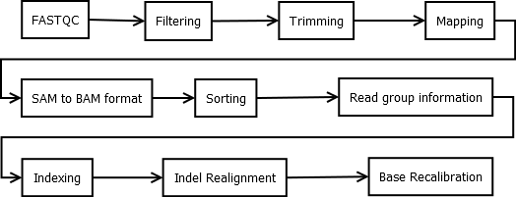
Preprocessing
Notes:
Before detecting the SNVs, the two samples need to be preprocessed.
The FASTQC program checks the quality of the sequenced DNA. There is a need to check the quality per base and the length of the read where the quality drops significantly.

Slide 10
Preprocessing
Notes:
The quality per base checked in previous step is used for the filtering. Reads with a Phred quality lower than 25 were filtered out.

Slide 11
Preprocessing
Notes:
The reads were here trimmed to a minimum length of 35 bp and a maximum length of 150 bp. The minimum length is set to filter out the very short reads, the maximum length is set at 150 bp because the quality of the read dropped significantly.

Slide 12
Preprocessing
Notes:
The tumor and blood samples are mapped to a reference human genome with a program called Bowtie2. The reference genome used is the UCSC Hg 19 version. This creates a file in SAM format.

Slide 13
Preprocessing
Notes:
The SAM format file containing the mapped tumor and blood samples is converted to a binary BAM format using SAMtools. This step is necessary because a BAM file is indexed and compressed thus more efficient to work with.

Slide 14
Preprocessing
Notes:
By sorting the BAM file the DNA strands are arranged from their ‘5 end to the ‘3 end.

Slide 15
Preprocessing
Notes:
The next steps in the preprocess acquire the BAM files to contain read group information. The only information known was the Ion Torrent sequencer used to sequence the samples. This is the only information that was added. The other read group parameters are not relevant to the Ion Torrent technology, but mostly to Illumina lane-based parameters.

Slide 16
Preprocessing
Notes:
Showing which read is in which position is done by indexing the BAM files and will make the next steps more quickly.

Slide 17
Preprocessing
Notes:
The indel realignment takes a file with all known insertions and deletions of the human genome and checks for these sites on the aligned tumor and blood sample. The previous mapping procedure tends to produce artifacts. This holds reads aligning on the edges of indels, these reads can be falsely detected as SNVs. Indel realignment cleans up these artifacts as well as around indels detected in the current sequencing data.

Slide 18
Preprocessing
Notes:
The last step is the Base Recalibration.It corrects for quality scores assigned by the sequencing machine. These scores are heavily subject to systematic errors which can lead to incorrect base quality scores.

Slide 19
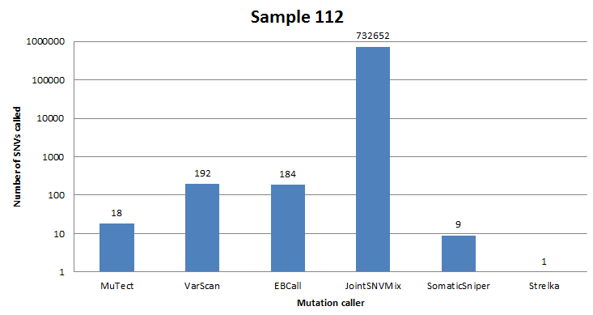
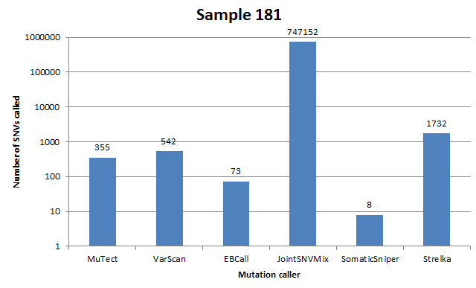
Standard parameters
Notes:
After the preprocessing, all six mutation callers were run with standard parameters and options. These two figures show the results of both samples. You can see a huge difference in the amount of somatic SNVs detected. VarScan, JointSNVMix and Strelka reported the most somatic SNVs in common. While MuTect, EBCall and SomaticSniper called almost none in common. This was the same for sample 181.

Slide 20
Optimized parameters
VarScan
Strelka
JointSNVMix
Depth of coverage
Threshold / Probability
Notes:
VarScan, Strelka and JointSNVMix were selected for further analysis. The most options could be changed in these tools plus they reported the most SNVs in common. I optimized the parameters to detect the most possible common SNVs while still ensuring a big amount of true SNVs. The depth of coverage was set to a minimum of 10 and the thresholds and probability to call a SNVs were optimized.

Slide 21
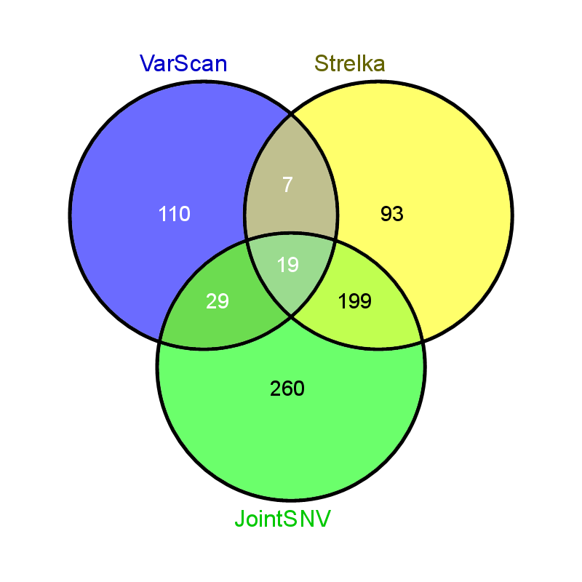
Optimized parameters
112
181
Notes:
The final results are shown in these two figures. For sample 112, there are 19 SNVs in common between the 3 mutation callers. While this is a 100 for sample 181. This is still a rather small amount considering the total amount of SNVs called. 19 is matched to 2% of the total SNVs for sample 112, while 100 SNVs is 3% for sample 181.

Slide 22
Conclusion
VarScan, JointSNVMix and Strelka
Most common
True somatic SNVs
Resequenced
Specificity + Accuracy
Poor documentation
Notes:
To conclude: VarScan, JointSNVMix and Strelka are the best mutation callers in my opinion. They report the most somatic SNVs in common and I could change the most options and parameters. In order to assure the commonly detected somatic SNVs are true, these positions need to be resequenced using Sanger sequencing. The specificity and accuracy of all six mutation callers need to improve a lot. There is also a need for better documentation about these tools.

Slide 23
Future perspectives
Further analyze
Non-synonymous variations
Interesting pathways
Mutation – gene – breast cancer
Therapeutic treatments
Notes:
The data of the commonly reported SNVs are passed on to the Department of Genetics at the University of Pretoria to further analyze. Only the non-synonymous variations in interesting pathways will be further sequenced and researched. When there is more information about the mutation, this can be linked to genes and specific breast cancers. Therapeutic treatments targeting genes can try to prevent or even cure the patient with the specific mutation.

Slide 24
A comparison of somatic mutation callers in breast cancer samples and matched blood samples
Thomas Bretonnet
Bioinformatics and computational biology unit University of Pretoria

