Slide 1
Validation of a method used for the monitoring of Cadmium and Mercury in different food commodities
Thijme Masschelein
Chemiphar (U) ltd

Slide 2
Content
Objective of this study
Food samples from Uganda
Heavy metals
Method of analysis
Parameters
Results & discussion
Conclusion & Recommendation

Slide 3
Objective of this study
Screening of Cd and Hg in food samples
Validation of Cd method by using F-AAS
Validation of Hg method by using FIMS

Slide 4
Content
Objective of the study
Food samples from Uganda
Heavy metals
Method of analysis
Parameters
Results & discussion
Conclusion & Recommendation

Slide 5
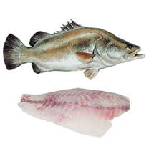
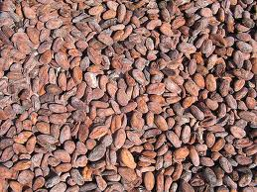
foodsamples
Economical
Robusta Coffee
Cocoa beans
Nile perch
Healthcare
Unimix
WFP
Malnutrition and hunger

Slide 6
Content
Objective of the study
Food samples from Uganda
Heavy metals
Method of analysis
Parameters
Results & discussion
Conclusion
Recommendation

Slide 7
Cadmium
Cadmium
In different kind of food
Crucial target organs :
Kidneys & Bones
Osteoporosis
Osteomalacia
Itai itai disease
By nature & humans

Slide 8
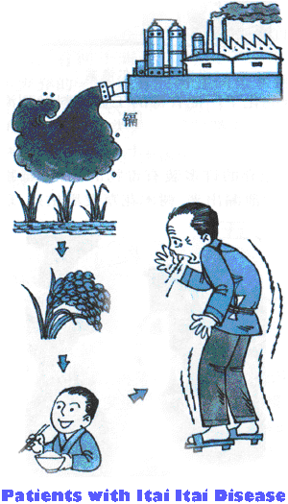
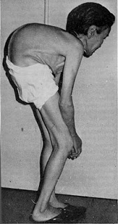
Itai itai disease

Slide 9
Mercury
Mercury
Nature & Industry
Ataxia, tremor
Reduction of hearing and visual
Mental and physical disability
Methylmercury
Minamata bay disaster
Neurotxin

Slide 10
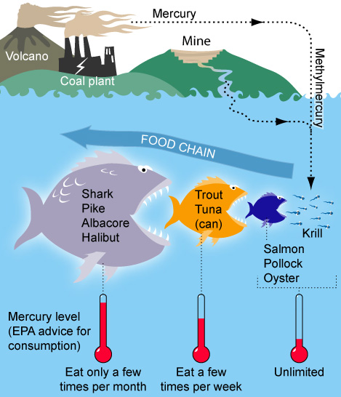
Minamata bay disaster

Slide 11
Content
Objective of the study
Food samples from Uganda
Heavy metals
Method of analysis
Parameters
Results & discussion
Conclusion & Recommendation

Slide 12
Method of analysis
Sample preparation
Microwave of hot-plate digestion
Microwave digestion : Faster and less chance on contamination
Method of analysis
Cadmium by Flame-AAS
Mercury by FIMS

Slide 13
Content
Objective of the study
Food samples from Uganda
Heavy metals
Method of Analysis
Parameters
Results & discussion
Conclusion & Recommendation

Slide 14
Validation parameters
Detection limit
LOD
LOQ
Linear range
Respons factor
Precision
Repeatability
Reproducibility
Trueness

Slide 15
Content
Objective of the study
Food samples from Uganda
Heavy metals
Method of analysis
Parameters
Results & discussion
Conclusion & Recommendation

Slide 16
Result Cd + Spike
Sample | Value
Fish | < 0,01 mg/kg
Coffee | < 0,02 mg/kg
Cocoa | < 0,02 mg/kg
Unimix® | < 0,02 mg/kg
Samples are negative on Cd
Spike
Wet sample → 25 mg/kg
Dry Sample → 50 mg/kg

Slide 17
Detectionlimit F-AAS
R² | 0,9986
LOD | 0,023 mg/kg
LOQ | 0,05 mg/kg

Slide 18
Linear range F-AAS
Concentration | Respons | Respons factor
0 | 0 | 0
0,1 ppm | 0,019 | 0,1900
0,2 ppm | 0,037 | 0,1850
0,3 ppm | 0,055 | 0,1833
0,4 ppm | 0,072 | 0,1800
0,5 ppm | 0,087 | 0,1740
0,9 ppm | 0,131 | 0,1456
1 ppm | 0,147 | 0,1470
RF : Respons/concentration
Mean value of RF → linear range between 95% and 105% of mean value RF

Slide 19
Linear Range F-AAS
Mean response factor | 0,1828
Mean – 5% | 0,1736
Mean + 5% | 0,1919

Slide 20
Precision
Replicate | Dixon Q-test
1 | 20,35
2 | 21,20
3 | 22,11
4 | 22,49
5 | 22,89
6 | 22,93
Mean value | 22,00
STDEV | 1,03
RSD % | 4,67
H-value | 10,05
2/3 H-value | 6,70
4/3 H-value | 13,40
Q-exp | 0,329 & 0,016
Q-crit | 0,56
H-value
H-value = RSD/PRSD
RSD < 2/3 H-value → repeatable
RSD < 4/3 H-value→reproducible
Dixon Q-test
Qcrit = 0,560
Qexp < Qcrit → no outliers
PRSD = 2.C^{-0,15}

Slide 21
Precision
Replicate | Dixon Q-test
1 | 47,05
2 | 47,30
3 | 47,39
4 | 47,87
5 | 48,32
6 | 49,38
Mean value | 47,89
STDEV | 0,86
RSD % | 1,80
H-value | 8,94
2/3 H-value | 5,96
4/3 H-value | 11,92
Q-exp | 0,107 & 0,455
Q-crit | 0,56

Slide 22
Trueness
Recovery
Spike
Theoretical spike
R%
Parameter = between 80% and 110 %

Slide 23
Recovery
Sample ID Wet | Concentration Procedure blank | Theoretical Spike (mg/kg) | Practical Spike (mg/kg) | Recovery
2013/02/116 | -0,18 | 21,11 | 20,35 | 97 %
2013/02/116 | -0,03 | 22,76 | 22,89 | 101 %
2013/02/116 | -0,05 | 22,68 | 22,90 | 101 %
Sample ID Dry | Concentration Procedure blank | Theoretical Spike (mg/kg) | Practical Spike (mg/kg) | Recovery
2013/02/092 | -0,69 | 48,45 | 47,87 | 100 %
2013/02/092 | -0,96 | 47,57 | 47,30 | 101 %
2013/02/092 | -0,31 | 48,31 | 47,39 | 99 %

Slide 24
Content
Objective of the study
Food samples from Uganda
Heavy metals
Method of analysis
Parameters
Results & discussion
Mercury
Conclusion & Recommendation

Slide 25
Results Hg + spike
Sample | Value on Mercury
Fish | < 0,01 mg/kg
Coffee | < 0,03 mg/kg
Cocoa | < 0,03 mg/kg
Unimix® | < 0,03 mg/kg
Samples are negative on Hg
Spike
Wet sample → 0,10 mg/kg
Dry Sample → 0,20 mg/kg

Slide 26
Results Hg + conclusion
 | Method Cadmium | Method Mercury
LOD | 0,023 mg/kg | 0,000096 mg/kg
LOQ | 0,05 mg/kg | 0,00019 mg/kg
Linear Range | Between 0,1736 – 0,1919 | Between 0,0282 – 0,0311
Repeatability | Repeatable No outlier | Repeatable No outlier
Reproducibility | Reproducible No outlier | Reproducible No outlier
Recovery | Within parameter | Within Parameter

Slide 27
Recommendations
General
Other heavy metals
Cadmium
ICP
Gf-AAS
Mercury
Microwave Digestion
CVAAS
CVAFS

Slide 28
Validation of a method used for the monitoring of Cadmium and Mercury in different food commodities
Thijme Masschelein
Chemiphar (U) ltd

Slide 29
Results Mercury
R² | 0,9999
LOD | 0,096 µg/l | 0,000096 mg/kg
LOQ | 0,19 µg/l | 0,00019 mg/kg

Slide 30
Mean response factor | 0,0297
Mean -5% | 0,0282
Mean +5% | 0,0311

Slide 31
Replicate | Dixon Q-test (mg/kg) | Q-value | Q-theory
1 | 0,171 | 0,066 | 0,56
2 | 0,172
3 | 0,173
4 | 0,177
5 | 0,185
6 | 0,186 | 0,077 | 0,56
Mean value | 0,177
STDEV | 0,01
RSD % | 3,85
H-value | 20,76
2/3 H-value | 13,84

Slide 32
Replicate | Dixon Q-test (mg/kg) | Q-value | Q-theory
1 | 0,078 | 0,055 | 0,56
2 | 0,080
3 | 0,086
4 | 0,087
5 | 0,094
6 | 0,111 | 0,525 | 0,56
Mean value | 0,089
STDEV | 0,01
RSD % | 13,26
H-value | 23,02
2/3 H-value | 15,35

Slide 33
Sample ID | Procedure blank (mg/kg) | Theoretical spike (mg/kg) | Practical Spike (mg/kg) | Recovery %
2013.02.092 | 0,006 | 0,172 | 0,185 | 104 %
2013.02.092 | 0,003 | 0,177 | 0,172 | 95 %
2013.02.092 | 0,007 | 0,187 | 0,186 | 96%
Sample ID | Procedure blank (mg/kg) | Theoretical Spike (mg/kg) | Practical Spike (mg/kg) | Recovery %
2013.02.116 | 0,007 | 0,099 | 0,112 | 105 %
2013.02.116 | 0,008 | 0,083 | 0,094 | 103 %
2013.02.116 | 0,002 | 0,088 | 0,086 | 97 %

Slide 34
Digestion
HNO3
H2O
H2O2
Filtreren
Aanlengen tot 25 ml

Slide 35
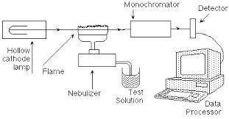
Analysis Cd

Slide 36
Advantages on F-AAS
Advantages of the GF-AAS | Disadvantages of the GF-AAS
Parts per billion (µg/) instead of part per million (mg/l) | Absorb gases
100 times more sensitive | Temperature gradient
Less sample needed | Needs more time than flame AAS
Zeeman background correction

Slide 37
Advantages | Disadvantages
Better detection limit than Flame- and GF-AAS | Expensive
Higher throughput | interference
Many different elements can be measured
High speed analysis
Higher temperature

Slide 38
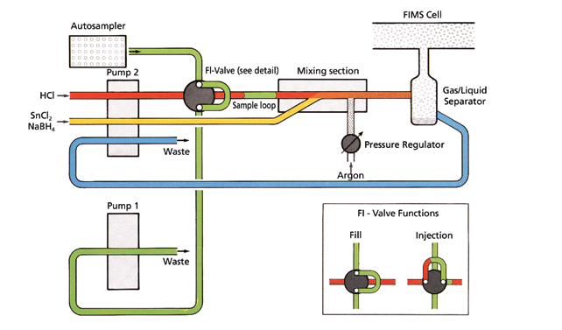
Analysis Hg

Slide 39
LOD

Slide 40
