Slide 1
Growth evaluation of Salmonella Enteritidis SE86 and Escherichia coli ATCC8739 on lettuce (Lactuca sativa L.) during two days of shelf-life at 5°C, 10°C, 25°C and 37°C
Student: Cordier Roxanne
Mentor: Prof. Eduardo Cesar Tondo
Promotor: Ellen Decat

Slide 2
Table of contents
Introduction
Bacteria
Methods
Results
Conclusion

Slide 3
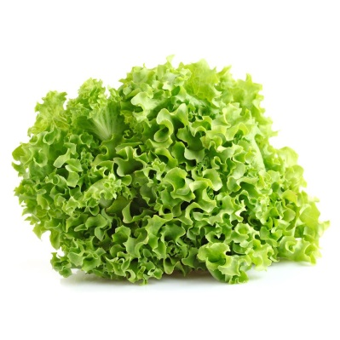
Introduction
The aim of this study
Growth evaluation of S. Enteritidis and E. coli on lettuce
Temperature and the time of growth
Two days of shelf-life
Different temperatures
Parameters:
Safely consume of lettuce
Appearance m.o.
Salmonella SE86
E. coli ATCC8739
Mesophiles
Notes:
Lettuce is one of the oldest leafy green cultivated around the world, and is one of the most consumed vegetable due to its availability, cost and nutritional factors. In Brazil about 40% of the volume that is traded in fresh produce supply companies is lettuce. To consume the lettuce safely, several critical control points of the different processes need to be run through, checked and approved. The control of these points can concern the appearance of micro-organisms, such as Salmonella enteritidis and E. coli. S. enteritidis and E. coli are one of the most common micro-organisms involved in foodborne outbreaks of vegetables and fruits. The mesophilic bacteria represent the normal flora of the vegetables.
The aim of this study is to determine the survival of S. enteritidis and E. coli on lettuce. Therefore two control points were considered important to study the behaviour of these bacteria, namely the temperature and the time of growth. The outbreak of these pathogens on leafy greens were researched at a shelf-life of two days and at different temperatures (5°C, 10°C, 25°C and 37°C).

Slide 4
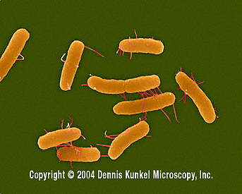
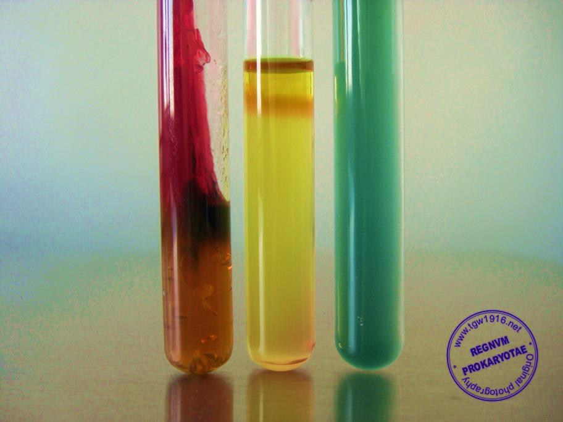
Bacteria
Salmonella enterica subspecies enterica serotype Enteritidis
Notes:
Salmonella is a Gram-negative, rod-shaped, facultative anaerobic, non-spore-forming bacterium, who is part of the Enterobacteriacea family.
Salmonellosis is an important cause of foodborne disease in the entire world and is a significant cause of morbidity, mortality and economic loss. Enteritis is the most common form of salmonellosis.
A H₂S positive strain, which is urease, indole, phenylalanine and Ortho-Nitrophenyl-β-galactoside (ONPG) negative and ferments no lactose, must always remind to Salmonella .

Slide 5
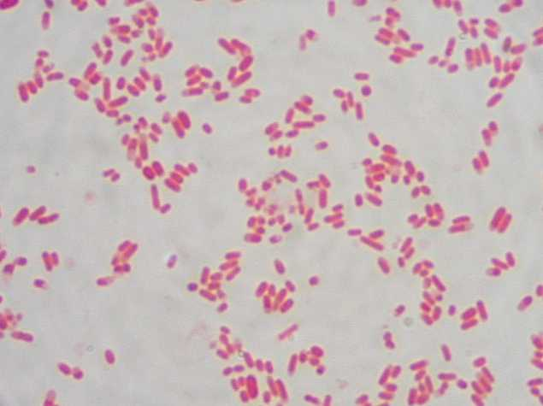
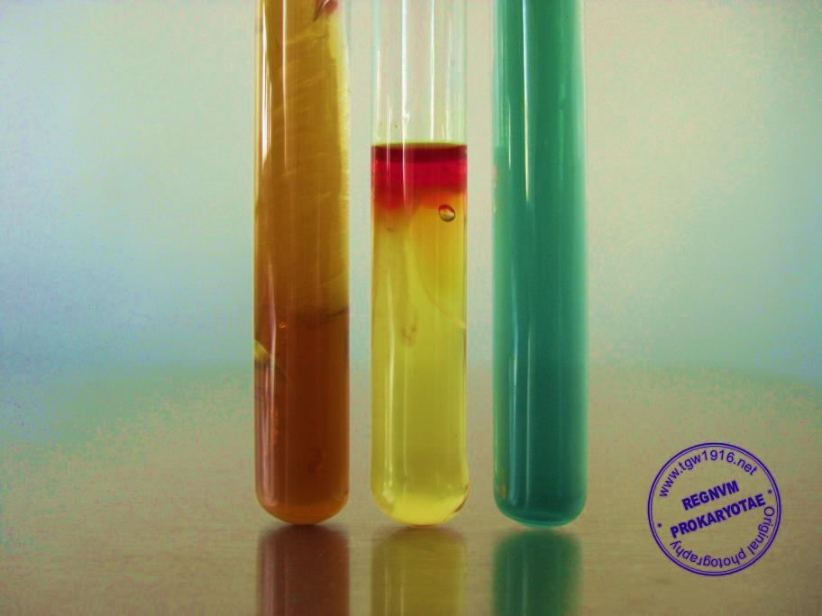
Bacteria
Escherichia coli
Mesophilic bacteria
37°C
Hygiene indicators → normal flora
Notes:
E. coli or coli bacilli are universal commensal intestinal parasites of animals and humans. This pathogen is a part of the Enterobacteriacea family. It is a gram-negative, facultative anaerobic, rod-shaped bacterium that is found in the lower intestine of warm-blooded organisms. The biochemical characteristics of E. coli are oxidase and citrate negative, gas production without H₂S-production, lactose, indole and catalase positive.
Mesophiles contains a lot of different types of micro-organisms, such as some species of Bacteria, Fungi and even some Archaea. The optimal temperature for these bacteria is between 30°C and 40°C, most of the time 37°C. This category of bacteria lives in the bodies of warm-blooded animals. These mesophiles are also hygiene indicators, because they are the bacteria that live on the normal flora of food products. [24]
The mesophilic bacteria that are most common found on lettuce are [17, 25]:
E. coli
Salmonella
Shigella
Clostridium
Listeria monocytogenes
Yersinia enterocolitica
Campylobacter jejuni

Slide 6
methods
Preparation of the inoculum
Notes:
On Sunday or Monday the bacteria are grown in the BHI or the TSBm, this for 18-24 hours. The following day it is used to inoculate the lettuce. The process that is used to have the right inoculum is the following (Figure 3-3):
Vortex the BHI/TSBm tube
Take 1 mL out of the BHI/TSBm tube and bring it in 9 mL of buffered peptone water (=10⁻¹)
Take 1 mL out of the 10⁻¹ tube and bring it in a second tube of 9 mL buffered peptone water (=10⁻²). This tube is used to inoculate the lettuce, 100 µL in each bag.
Make a 10⁻³, 10⁻⁴, 10⁻⁵ and a 10⁻⁶ dilution by the same method as before and plate the 10⁻⁵ and 10⁻⁶ on either a XLD-plate (for Salmonella) or a CC-plate (for E. coli) to count the inoculum.

Slide 7
Methods
Lettuce incubation
5°C
25°C
10°C
37°C
10 g of lettuce
Times: 0, 2, 6, 24 & 48 hours

Slide 8
Methods
Analyse method
Preparation & inoculation
Analyse
Notes:
After preparation and inoculation of the lettuce, the analyse method starts. When incubation time (0, 2, 6, 24 or 48) ended, the lettuce was taken out of the incubator. The next step was re-weighing the lettuce, and note down the mass of the lettuce. After this, buffered peptone water was added to the bag to dilute the mass to one-tenth.
The following step was to stomacher the bag of lettuce, so that the buffered peptone water, the lettuce and thus the inoculated bacteria mingle. Stomacher for one minute by hand or with the stomacher itself, in this research it was done by hand. Ending these processes, the analyse could be continued by making more dilutions. The number of dilutions depends on the temperature, the type of bacteria and the time that the lettuce has been incubated. Dilutions were made by taking first 1 mL of the bag with lettuce (=10⁻¹) and dilute in a 9 mL tube of buffered peptone water (=10⁻²). The next dilution (=10⁻³) was made by taking 1 mL out of the 10⁻²-tube and dilute in another 9 mL tube of buffered peptone water. More dilutions were made by the same method. Note, that each time a dilution was made it was mixed by the vortex, before using it for another dilution. When the dilutions were ready, the right dilutions were chosen to plate out on the XLD-, CC- or NA-plates. These were plated by the droplet-method and were performed in the biosafety cabin or next to a Bunsen burner. Before plating, the test tubes with the right dilutions were mixed by the vortex to be sure that the dilution was well mingled. After applying the dilutions on to the plates, the plates were openly placed in the safety cabin to dry. When the drops were dry, the plates could be placed in the incubator at 37°C for 18-24 hours.

Slide 9
Methods
Incubation method
37°C
XLD, NA & CC
22 hours
Counting → results → growth curve
Statistical method
Software SPSS ~ Tukey test
95% of confidence level (α = 0,05)
Notes:
After analysing, the XLD-plates, NA-plates and CC-plates were placed in the incubator at 37°C and incubated for 22 hours. After these 22 hours, the plates were counted and the results were noted.
The statistical analyses were performed on the Software SPSS version 22 (IBM Statistics®). The comparison between bacterial counts was made by Tukey Test, considering 95% of confidence level, α =0,05.

Slide 10
Results 5°C
Notes:
At a temperature of 5°C, the behaviour of the bacteria that were used on this study, namely Salmonella, E. coli and the mesophilic bacteria, decrease. Hereby, it can be concluded that when a contaminated lettuce is bought and kept under refrigerated temperature (5°C) for 48 hours, there is decrease of 0,1 log₁₀ CFU/g for Salmonella and 0,8 log₁₀ CFU/g for E. coli.

Slide 11
Results 10°C
Notes:
When serving the lettuce in food services at 10°C, the growth of the mesophiles and pathogenic bacteria remains steady-state. Once good practices are applied by the food service and the disinfection-process is effective, there should be no bacteria on vegetables. But if cross-contamination occurs on lettuce, there will be no growth of Salmonella and E. coli.

Slide 12
Results 25°C
Notes:
Reaching the usual room temperature (25°C) in South Brazil there can be concluded that the both pathogens, Salmonella and E. coli grow similar in time. After two days of shelf-life at this temperature, the counts exceed more than one log₁₀ CFU/g. This demonstrates that room temperatures are not ideal for maintaining the lettuce.

Slide 13
Results 37°C
Notes:
The growth observed for Salmonella and E. coli at their optimum temperature (37°C), increase until 24 hours and continue to the point of 48 hours with a reduction. The trend of both bacteria is similar to the growth curve of every bacteria.

Slide 14
Conclusion
5°C: Salmonella & mesophiles stagnate & E. coli decreases.
10°C: steady-state
25°C: growth in time
37°C: increase until 24 hours + reduction until 48 hours
The influence of different temperatures
lettuce < 10°C
disinfect the lettuce
maintain the lettuce under refrigerated temperature
Notes:
At a temperature of 5°C, the behaviour of the bacteria that were used on this study, namely Salmonella, E. coli and the mesophilic bacteria, decrease.
When serving the lettuce in food services at 10°C, the growth of the mesophiles and pathogenic bacteria remains steady-state.
Reaching the usual room temperature (25°C) in South Brazil there can be concluded that the both pathogens, Salmonella and E. coli grow similar in time.
The growth observed for Salmonella and E. coli at their optimum temperature (37°C), increase until 24 hours and continue to the point of 48 hours with a reduction.
This study demonstrates the influence of different temperatures on the growth of two distinct pathogens. Due to this, it can be concluded that if there is some contamination, the lettuce can be kept until 10°C without a significant growth. Above these temperatures there is a plenty growth of the pathogens, being a risk for the consumers. Thus it is suggested for consumers and foodservices to disinfect the lettuce before consumption or serving. Furthermore to avoid the growth of remaining bacteria, the lettuce should be maintained under refrigerated temperature.

Slide 15
Growth evaluation of Salmonella Enteritidis SE86 and Escherichia coli ATCC8739 on lettuce (Lactuca sativa L.) during two days of shelf-life at 5°C, 10°C, 25°C and 37°C
Student: Cordier Roxanne
Mentor: Prof. Eduardo Cesar Tondo
Promotor: Ellen Decat

