Slide 1

The BALTAZAR project: detection and quantification of amyloid peptides, BACE1, TACE and Cathepsin D in the cerebrospinal fluid of patients with AD and MCI
CHU Saint Eloi, Montpellier
Laboratoire de Biochimie et Protéomique Clinique (LBPC)
Germien Nuytten
Notes:
Good afternoon, my name is Germien Nuytten and during the past 4 months, I did my internship in LBPC in Montpellier. Today, I will tell you about the BALTAZAR project. More particularly about the detection and quantification of amyloid peptides, BACE1, TACE and Cathepsin D in the cerebrospinal fluid of patients with AD and MCI.

Slide 2
Table of contents
Introduction
  BALTAZAR project
  Alzheimer’s disease (AD)
  Mild cognitive impairment (MCI)
  Formation of amyloid beta (Aβ)
  Different types of amyloid beta (Aβ)
Methods
Results and discussion
Conclusion and future perspectives
Notes:
The following will be discussed: an introduction to all the important terms used in this project, the used methods, results and discussion and finally the conclusion together with future perspectives.

Slide 3
BALTAZAR project
= Biomarker of AmyLoid peptide and AlZheimer’s diseAse Risk
Relationship between biomarkers and the risk of conversion from MCI to AD is examined in more than 1000 subjects
Biomarkers that are tested in this bachelor project:
  BACE1
  TACE
  Cathepsin D
  Aβ-40
  Aβ-42
Notes:
First of all, BALTAZAR is an abbreviation of Biomarker of AmyLoid pepTide and AlZheimer’s diseAse Risk. For this project, the relationship between several biomarkers and the risk of conversion from MCI to AD is examined in more than 1000 subjects. sAPPβ, Aβ-40, Aβ-42 and other biomarkers are investigated in both plasma and CSF. For my bachelor project however, I focus on the detection of BACE1, TACE, Cathepsin D, Aβ-40 and Aβ-42 in CSF.

Slide 4
Alzheimer’s disease (AD)
Most common neurodegenerative disorder resulting in dementia
Difficulties in performing basic tasks and short term memory + psychological alterations
Typical hallmarks of AD:
  Extracellular aggregations of amyloid beta (Aβ) peptides = plaques
  Intracellular interwoven fibers of abnormally hyper-phosphorylated protein tau = tangles
  General brain atrophy
Brain volume shrinks significantly
Notes:
Now, I give you a little introduction to Alzheimer’s disease or AD. Currently, AD is the most common neurodegenerative disorder resulting in dementia. Early symptoms of AD appear as difficulties in performing basic tasks and short term memory (for example in recalling names or recent events), but psychological alterations are also seen such as apathy or depression. As the disease progresses, these symptoms become more severe and other cognitive problems, such as difficulties in speaking, swallowing, motor control, … appear. When looking at cellular level, several typical hallmarks of AD can be found: extracellular aggregations of amyloid beta (Aβ) peptides, also known as plaques, and intracellular interwoven fibers of abnormally hyper-phosphorylated protein tau, and are called tangles. General brain atrophy is also seen. Due to these three main reasons, the brain volume shrinks significantly, which can clearly be seen in the figure.

Slide 5
Mild cognitive impairment (MCI)
More problems with memory than normally seen at that age
Evolution MCI:
  Stay stable for many years
  Improvement
  Conversion to AD
Also plaques and tangles present in brain
Is MCI an early phase of AD or an independent disease?
Notes:
Another common neurodegenerative disease is mild cognitive impairment or MCI. As people get older, it is common to forget things or names sometimes, or having troubles to find the right word. However, in MCI patients, these problems are worse than normally seen in people of that age without the disease. Other symptoms are losing the train of thought in conversations or books, get lost in a familiar environment, become more impulsive, having difficulties in judging, making decisions or following instructions. Patients with MCI can stay stable for many years, or improve (although this doesn’t occur much) or it can become worse and converse to AD. Studies indicate MCI patients often (but not always) undergo the same changes in their brains like AD patients or other dementia forms, but they occur in a lesser degree. Thus, Aβ-plaques and tau-tangles can also be found. Nowadays, the question remains if MCI is an early phase of AD, or a disease independent of AD. Further research has to be done to check this possible relationship.

Slide 6
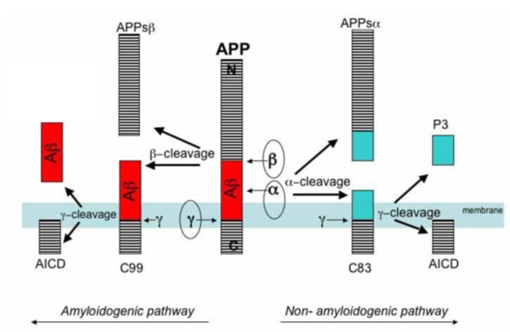
Formation of amyloid beta (Aβ)
Amyloidogenic pathway (β-secretase and γ-secretase)
→ Formation of Aβ
Non-amyloidogenic pathway (α-secretase and γ-secretase)
→ No formation of Aβ
BACE1 = β-secretase
Cathepsin D = β-secretase
TACE = α-secretase
Notes:
So a typical phenomenon in AD and MCI is the presence of amyloid beta plaques in the brain tissue. Aβ is formed out of a precursor protein, APP, by the cleavage of certain enzymes. As seen in the figure, this cleavage can follow the amyloidogenic pathway and form Aβ, or it can follow the non-amyloidogenic pathway where no Aβ is formed. When following the amyloidogenic pathway, APP is first cleaved by a β-secretase and afterwards by γ-secretase. Examples of β-secretases are BACE1 and CatD. When the non-amyloidogenic pathway is followed, APP is first cleaved by an α-secretase, such as TACE, and afterwards with γ-secretase. This leads to the formation of another peptide than Aβ, which means this pathway can preclude the formation of Aβ.

Slide 7
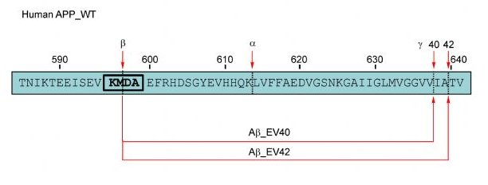
Different types of amyloid beta (Aβ)
Cleavage by γ-secretase is somehow variable
Formation of Aβ-peptides of different lengths
Notes:
Thus, when Aβ is formed, C99 is cleaved by γ-secretase. However, this cleavage of γ-secretase is somehow variable, resulting in the formation of Aβ-peptides of different lengths. This can clearly be seen in the figure. The majority (80-90 %) of the formed peptides consists of 40 amino acids (Aβ-40). About five to ten percent of Aβ consist of 42 amino acids (Aβ-42).

Slide 8
Table of contents
Introduction
  BALTAZAR project
  Alzheimer’s disease (AD)
  Mild cognitive impairment (MCI)
  Formation of amyloid beta (Aβ)
  Different types of amyloid beta (Aβ)
Methods
Results and discussion
Conclusion and future perspectives
Notes:
Now, the used methods to detect these enzymes and peptides are discussed.

Slide 9
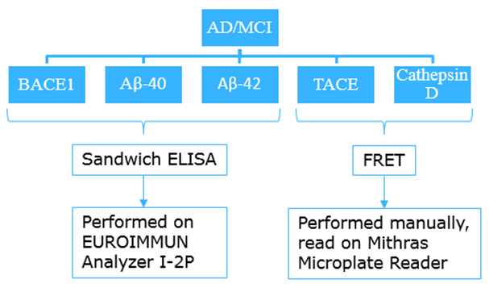
Methods
Two used methods:
  Sandwich ELISA
  Fluorescence Resonance Energy Transfer (FRET)
Notes:
Two different methods are used. A sandwich ELISA for the detection of BACE1, Aβ-40 and Aβ-42. This is performed automatically using the EUROIMMUN Analyzer I-2P. The other used method is Fluorescence Resonance Energy Transfer or FRET to detect TACE and Cathepsin D. These tests are performed manually, and the fluorescence is measured with the Mithras Microplate Reader.

Slide 10
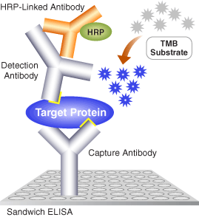
Methods
Sandwich ELISA
Coated microtiter plate
Adding sample + biotinylated detection antibody
Adding conjugate
Adding substrate
Adding stop solution
Photometric measurement
Notes:
For a sandwich ELISA, the used microtiter plate is coated with monoclonal capture antibodies, which can bind specifically to human BACE1/Aβ-40/Aβ-42. First, the CSF-sample is loaded together with a biotinylated detection antibody, which is also specific for human BACE1/Aβ-40/Aβ-42. An incubation step is performed to give the molecules the opportunity to bind to each other. Then, a washing step is executed to remove all of the unbound molecules. Afterwards, the conjugate is added, which is streptavidin poly-horseradish-peroxidase (SV-polyHRP) in this protocol. Because biotin and streptavidin have a large affinity for each other, they bind when they are present in the same environment. Again, an incubation and a washing step are performed. For the detection, TMB is added, which is a substrate for peroxidase. An incubation gives peroxidase the opportunity to oxidize TMB, resulting in a blue color. After this incubation, sulfuric acid is added to stop this reaction, resulting in a change of color from blue to yellow. The final step is the photometric measurement of the microtiter plate at two different wavelengths: one for the samples and one for a reference (to subtract the background signal).

Slide 11
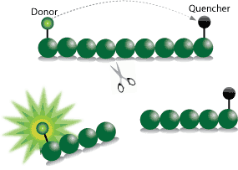
Methods
FRET-peptide
Fluorophore = fluorescent donor
Quencher = non-fluorescent acceptor
Used peptides contain cleavage site for TACE or Cathepsin D
Peptide is fragmented when added to sample
Light is produced and measured
Notes:
A FRET-peptide consists of an amino acid sequence with a fluorophore and a quencher attached to each side of this sequence. The fluorophore can be seen as a fluorescent donor, while the quencher is a non-fluorescent acceptor. Normally, when a fluorophore is emitted, it reaches its excited state. When returning to its ground state, light is produced. Although, in a FRET-peptide, this produced light is absorbed by the quencher so no light change can be observed. Nevertheless, the used peptides in this bachelor project contain a cleavage site for TACE and CatD respectively. So when this FRET-peptide is added to a sample containing the respective enzyme, the peptide is cleaved into fragments. By designing the peptide so that this cleavage separates the fluorophore and quencher, light is produced when the sample is emitted. This is due to the fact that the quencher is not able to absorb the produced light by the fluorophore anymore.

Slide 12
Table of contents
Introduction
  BALTAZAR project
  Alzheimer’s disease (AD)
  Mild cognitive impairment (MCI)
  Formation of amyloid beta (Aβ)
  Different types of amyloid beta (Aβ)
Methods
Results and discussion
Conclusion and future perspectives
Notes:
Now, I will give the results and discussion. The results for BACE1 are not in this presentation because the tests still need to be performed. For Aβ-40 and Aβ-42, 152 samples are tested. Since TACE and CatD are first tested on 90 samples, these results are discussed first. Then, the decision is made if additional tests are performed to verify the relationship between AD/MCI and the enzyme. When all samples are tested, all results are discussed afterwards.

Slide 13
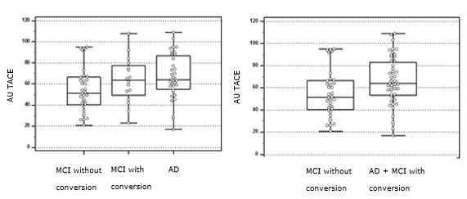
Results and discussion: TACE (90 samples)
Higher values for MCI with conversion and AD
Hypothesis: feedback mechanism?
Contradiction to what is found in literature
Notes:
First, the results of the first 90 samples for TACE are discussed. An increase in enzymatic activity in samples with AD can be seen, in comparison to the samples with MCI. Also, there is an increase in samples with converted MCI, compared to samples with MCI that has not converted. Since TACE is an α-secretase, and thus contributes to the prevention of forming harmful Aβ-peptides, it is expected that lower values of TACE are obtained for samples with AD. This is a contradiction to what is found in the literature, but can be explained by a feedback mechanism of the body against the large amount of Aβ-peptides. When a lot of harmful Aβ-peptides are present in the brain, the body defends itself by producing more α-secretase (TACE) in order to try to reduce this amount of peptides. Higher values are seen in samples with AD and converted MCI compared to those of MCI that has not converted, probably due to the higher amount of Aβ and thus a larger feedback mechanism. Although, these results do not give enough evidence for this hypothesis, so the decision is made to test extra samples to find a better correlation.

Slide 14
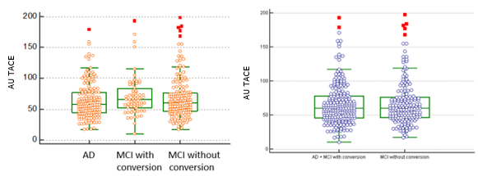
Results and discussion: TACE (all samples)
Slightly higher values for AD and MCI with conversion
TACE can be used as biomarker to predict the risk of conversion
TACE has an influence on the risk of conversion to AD
Notes:
The results for TACE of all the samples show slightly higher values for AD and MCI with conversion compared to MCI without conversion. Again, this can be explained by the feedback mechanism. This result indicates that TACE has an influence on the risk of conversion to AD and can thus be used as a biomarker to predict this risk.

Slide 15
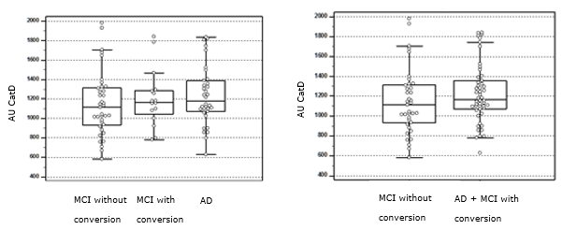
Results and discussion: Cathepsin D (87 samples)
Higher values for AD
Almost identical for MCI with and without conversion
Hypothesis: plays a role in development of AD, but not in MCI?
Corresponds to what is found in literature for AD
Notes:
Cathepsin D was first tested on 87 samples. The multiple comparison graph shows a value which is almost identical for samples with converted MCI and samples without conversion. On the other hand, the values of samples with AD is higher than the other two groups. The fact that samples with AD have higher values corresponds with the literature. This is because CatD is a β-secretase and thus contributes to the formation of Aβ. However, the enzyme seems to have little effect on MCI, since no difference can be seen between the converted and unconverted samples. To verify this hypothesis, the decision is made to test additional samples.

Slide 16
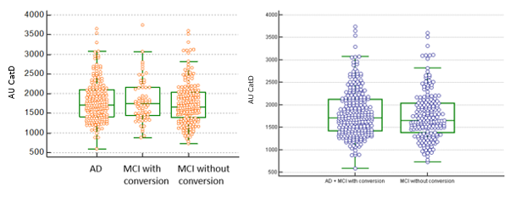
Results and discussion: Cathepsin D (all samples)
Slightly higher values for AD and MCI with conversion
Cathepsin D can be used as biomarker to predict the risk of conversion
Cathepsin D has an influence on the risk of conversion to AD
Notes:
The graphs for all the samples of Cathepsin D show slightly higher values for samples with AD and MCI with conversion. This is not very clear, but it means that the enzyme can be used as a biomarker to predict the risk of conversion from MCI to AD.

Slide 17
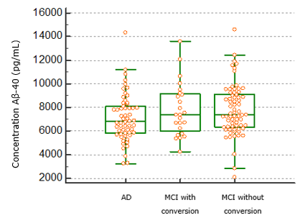
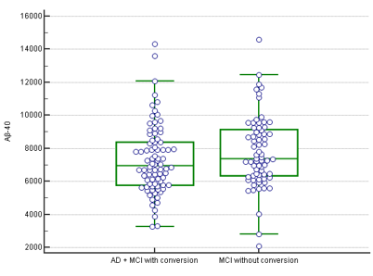
Results and discussion: Aβ-40 (152 samples)
Lower values for AD
No difference between MCI with conversion and MCI without conversion
Corresponds to what is found in literature
Concentration Aβ-40 (pg/mL)
Notes:
Also, the results of 152 samples for Aβ-40 and Aβ-42 are discussed. For Aβ-40, lower values are obtained for samples with AD, but the same results are seen for samples with MCI with and without conversion. For AD, this corresponds with the literature, since more Aβ-40 is drawn away into plaques, and is thus less present in CSF. Since no difference can be seen between MCI with and without conversion, the biomarker can not be used to predict the risk of conversion to AD.

Slide 18
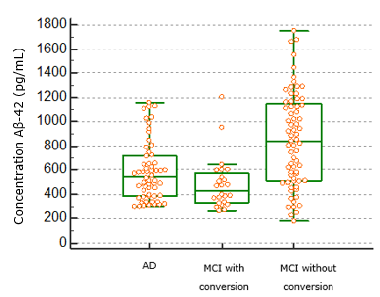
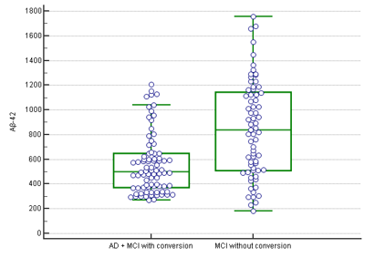
Results and discussion: Aβ-42 (152 samples)
Lower values for AD and especially for MCI with conversion
Aβ-42 is a very interesting biomarker to predict the risk of conversion to AD
Corresponds to what is found in literature
Concentration Aβ-42 (pg/mL)
Notes:
The graph of Aβ-42 show lower values for AD and especially for MCI with conversion. Again, this corresponds to the literature because more Aβ-42 is aggregated into plaques. Since plaques in the brain consist mainly of Aβ-42, this difference in concentration is very clear. Due to this big difference between samples of MCI with and without conversion, Aβ-42 is a very interesting biomarker to predict the risk of conversion.

Slide 19
Table of contents
Introduction
  BALTAZAR project
  Alzheimer’s disease (AD)
  Mild cognitive impairment (MCI)
  Formation of amyloid beta (Aβ)
  Different types of amyloid beta (Aβ)
Methods
Results and discussion
Conclusion and future perspectives
Notes:
Now the conclusion and future perspectives.

Slide 20
Conclusion and future perspectives
Potential biomarkers to predict the risk of conversion to AD:
  TACE
  Cathepsin D
  Aβ-42!!!
TACE and Cathepsin D can not be used as a single biomarker, a panel of biomarkers needs to be made
Future perspectives:
  Test all samples for Aβ-40 and Aβ-42
  Test all samples for BACE1
Notes:
The conclusion is thus that 3 potential biomarkers are found to predict the risk of conversion from MCI to AD. These are TACE and Cathepsin, although these are not that interesting. An option is to use these biomarkers together with other biomarkers, to be able to predict the risk of conversion more accurately. Aβ-42 seems to be a very interesting biomarker. In the future, all the samples for Aβ-40 and Aβ-42 need to be tested to verify if these peptides can be used as biomarker. Also, the tests for BACE1 need to be done.

Slide 21

Notes:
Thank you for your time and for listening! Please feel free to ask questions.

